Slide 1
Unit Visualizations meet the Grammar of Graphics
Dr. Steven M. Drucker
Partner Principle Researcher
Manager – Visualization and Interactive Data Analysis Group (VIDA)
Microsoft Research

Slide 2
Outline:
What are Unit Visualizations?
History (tallies -> IsoTypes->dot plots -> particle charts)
Informal Definition
Why are they useful?
Coins
Artifacts
Simpson’s Paradox
Baye’s Rule
General tools for using Unit Visualization
SandDance (titanic)
SandDance (demographics)
Stories (Titanic)
Creating unit visualization layouts
VEGA
ATOM
Limitations and
Single view that has preaggregated values without multiple features and grouping
Summary

Slide 3
What are Unit Visualizations?

Slide 4
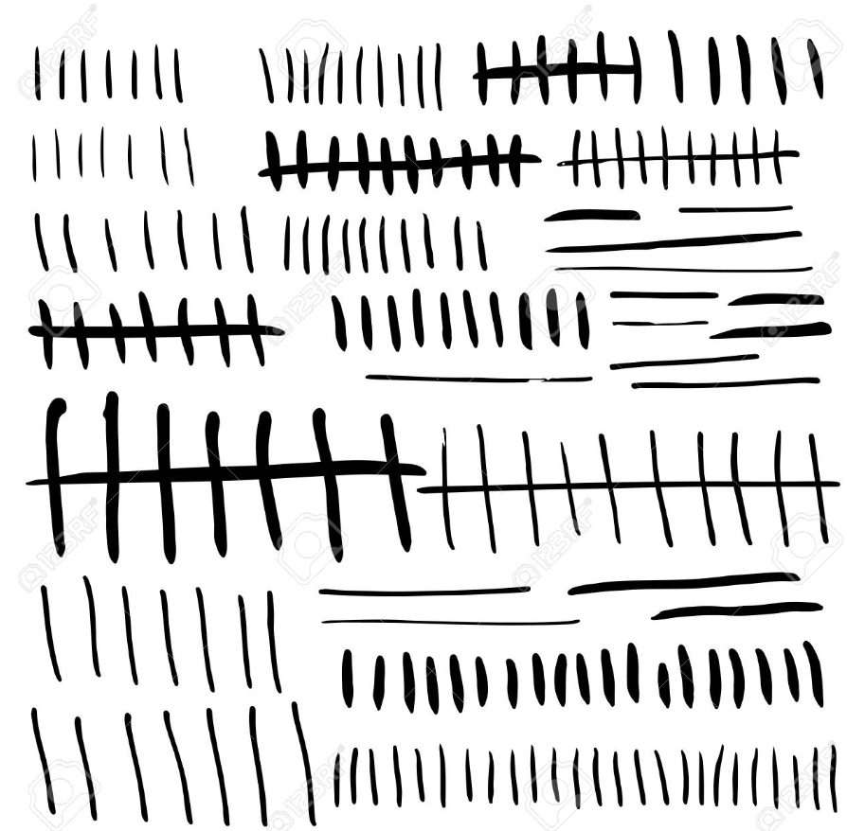
Tallies
Sumeria ~2100 BC

Slide 5
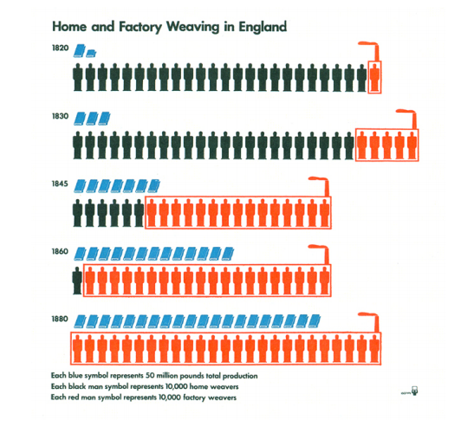
Isotypes
Otto Neurath, 1936

Slide 6

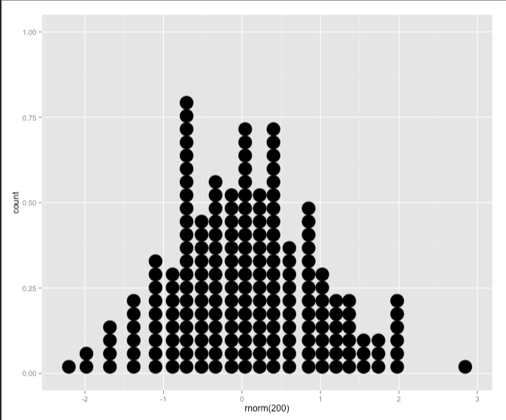
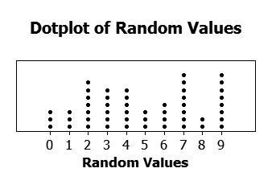
Dot Plots
Cleveland, 1993
Wilkinson, 1999

Slide 7
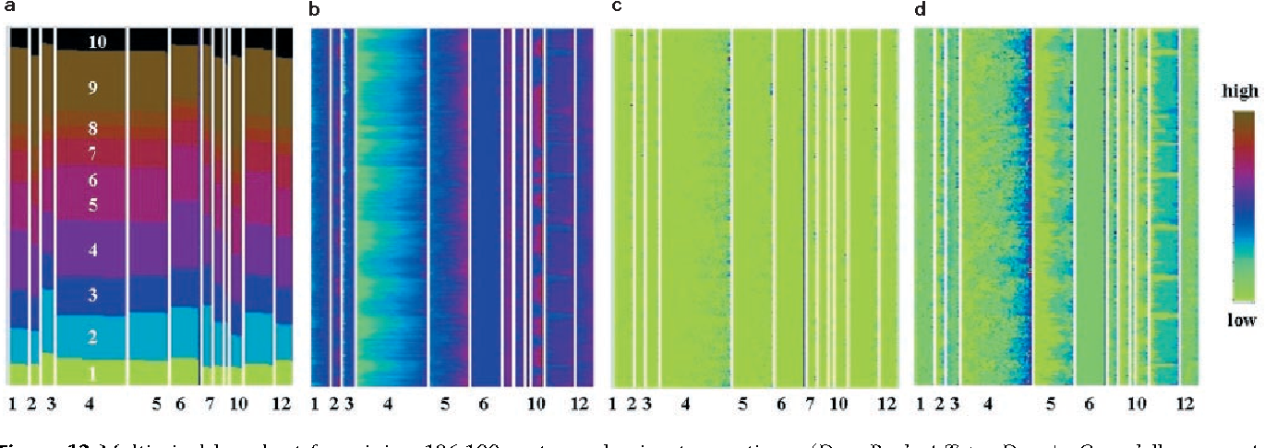
Keim – Pixel Charts
Keim, Daniel A. et al. “Pixel bar charts: a visualization technique for very large multi-attribute data sets?” Information Visualization 1 (2002): 20-34.

Slide 8
Semi-formal definition
Layout of a visualization where every row of dataset is represented as a mark in the visualization either without any aggregation or aggregated into uniform quantities.
Layout is structured to show both overall organization as well as individual quantities.
Creates opportunity for a family of related visualizations where marks are rearranged, images, colored, or sized to help convey meaning.
Layouts can include scatterplots, bar/column charts, treemaps, product plots.

Slide 9
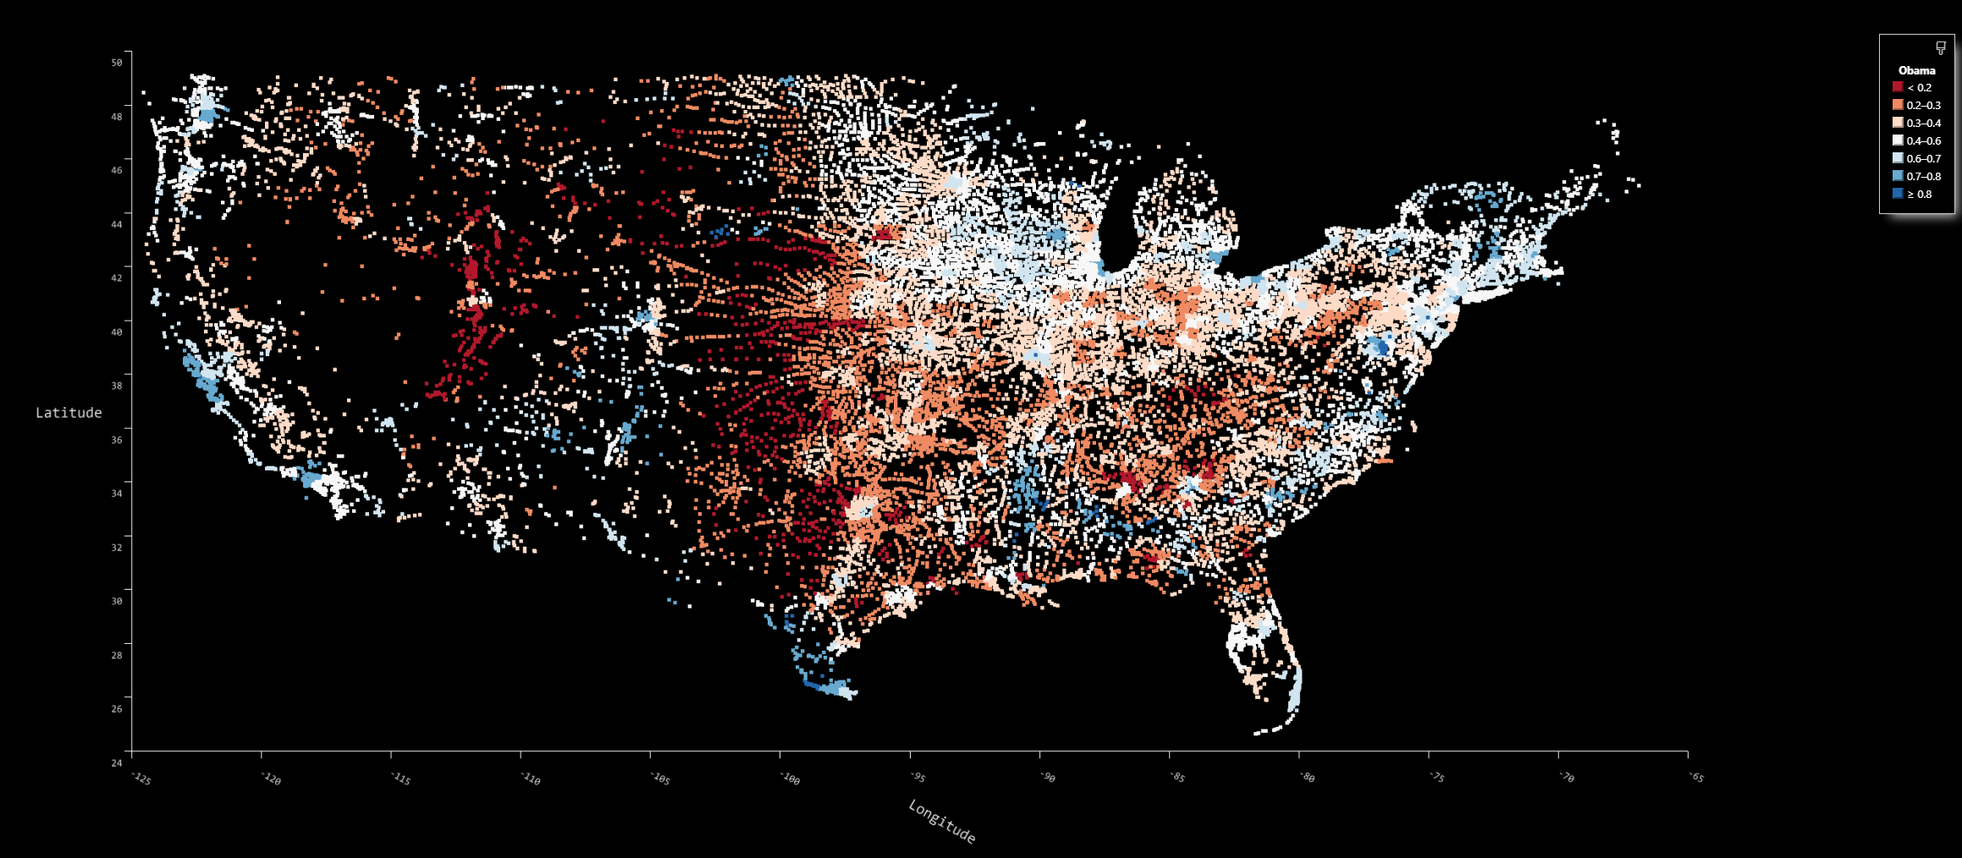
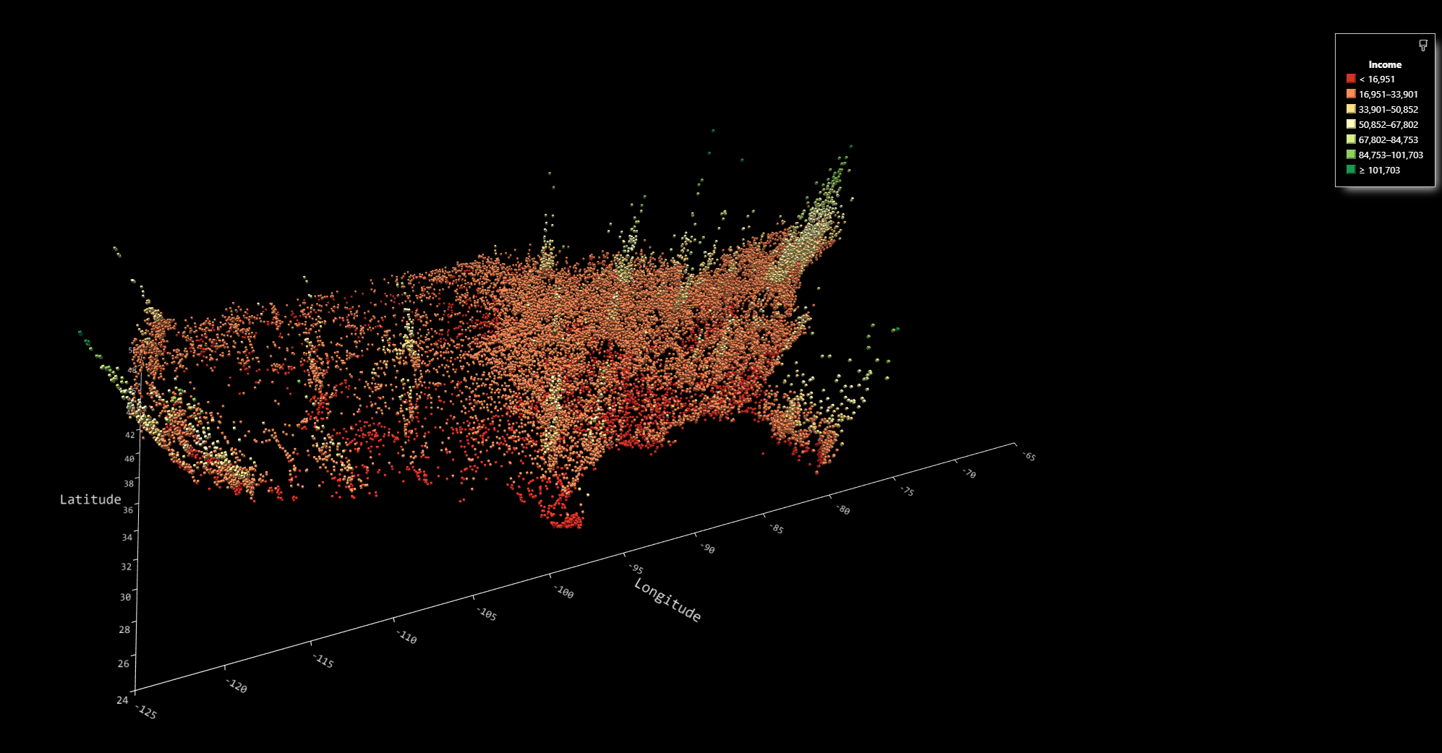
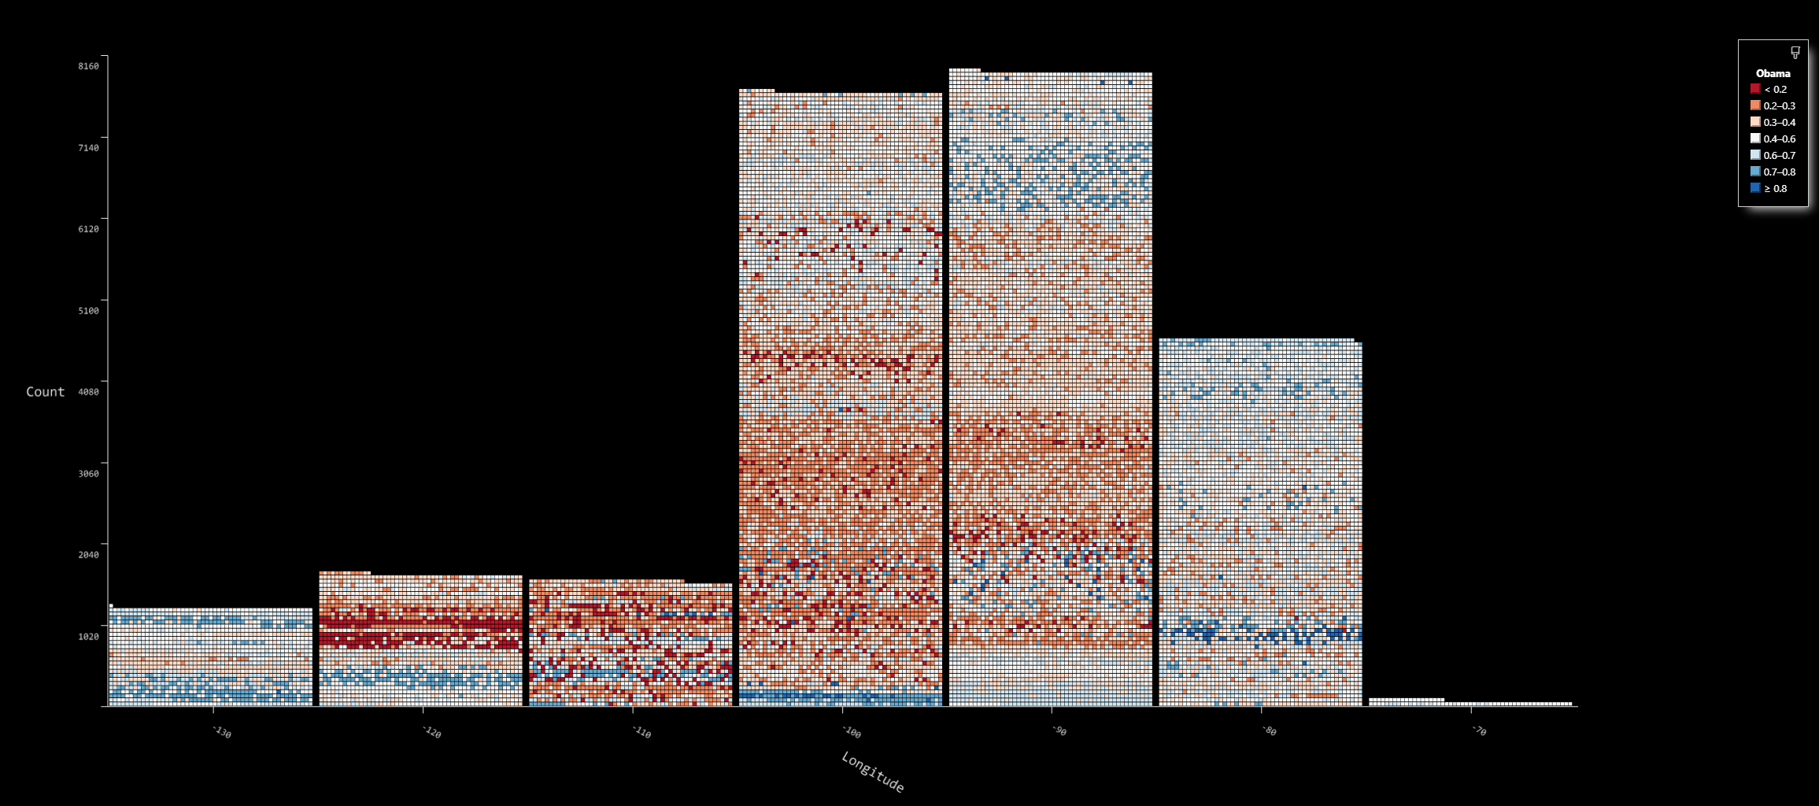
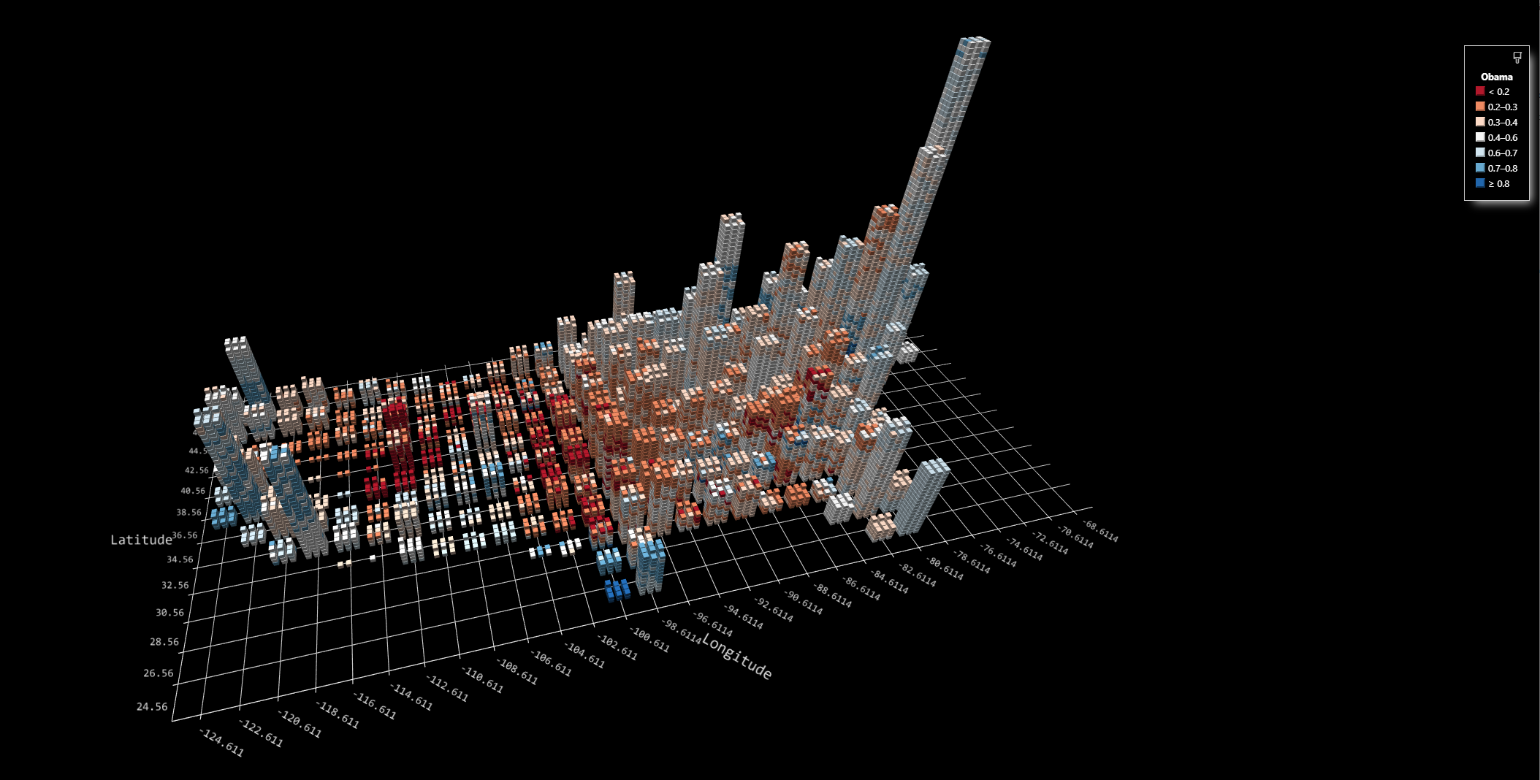
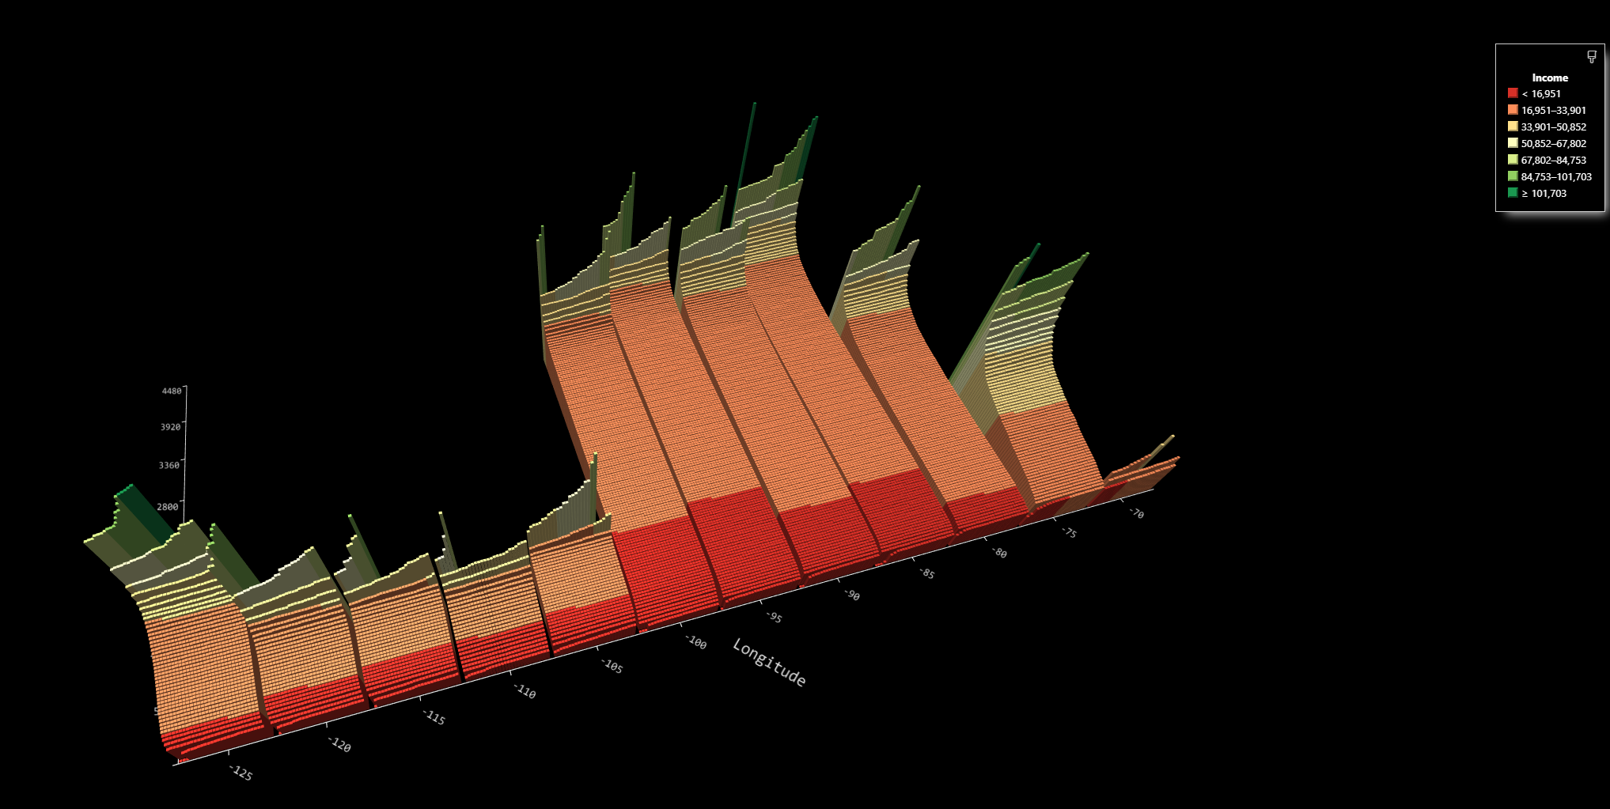
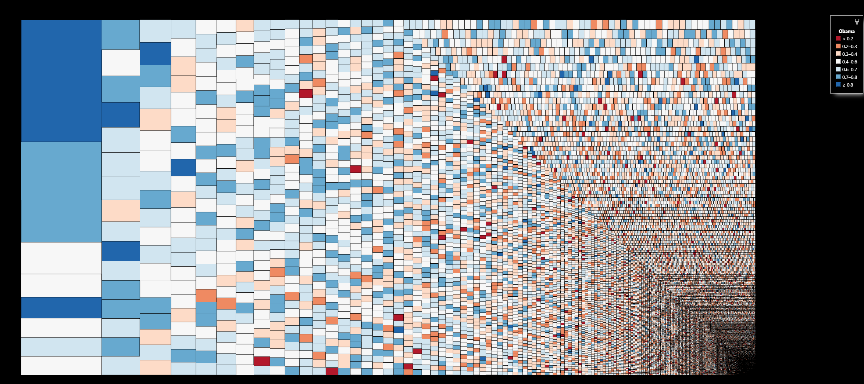

Slide 10
Unit Vis & Grammar of Graphics
data and aesthetic mappings
geometric objects
scales
facet specification (part of layout)
statistical transformations (no aggregation)
the coordinate system

Slide 11
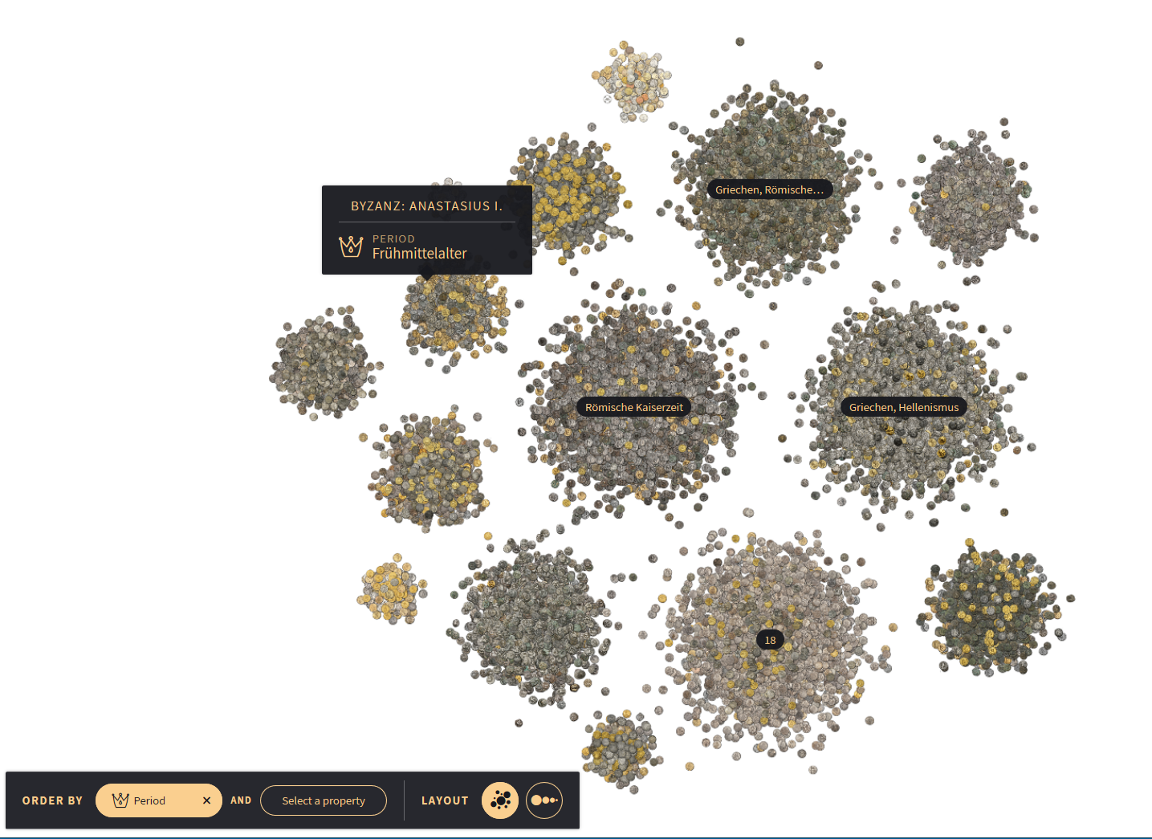
Coins
Marian Dork,
Flavio Gortana
https://uclab.fh-potsdam.de/coins/

Slide 12
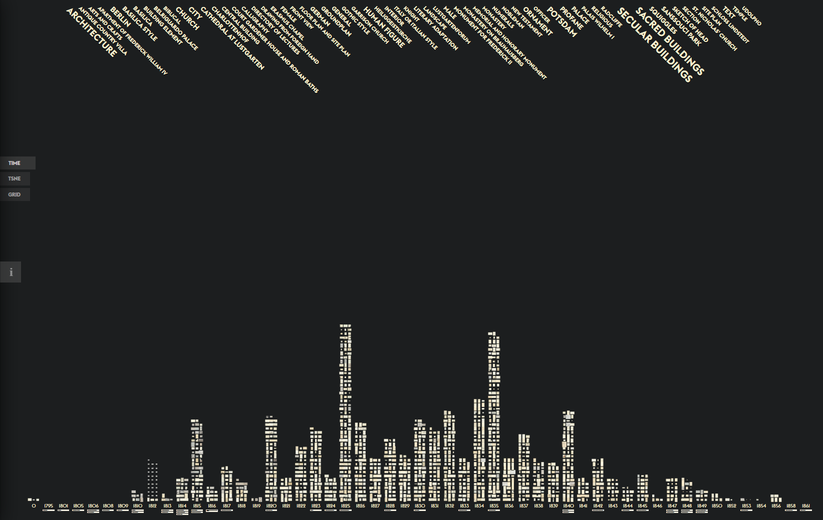
Past Visions
Marian Dork
Christopher Pietsch
https://uclab.fh-potsdam.de/fw4/en/vis/

Slide 13
Livelabs Pivot Video
https://www.youtube.com/watch?v=BZuFUZpEZ-A

Slide 14
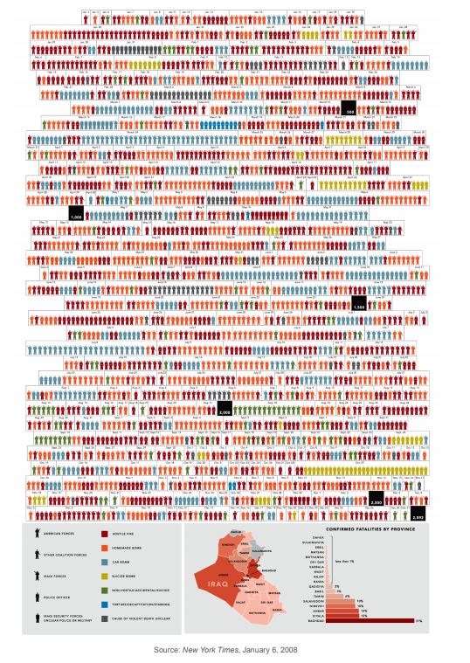
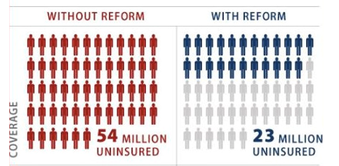
Unit Charts are for kids – Few, 2010
This simple icon that represents one or more people (in this case 1 million) is a staple of infographics. Although, by using this familiar icon the reader is instantly clued into the fact that people are the subject of the display, the values cannot be discerned without counting the icons or more simply reading the numbers (for example, 54 million uninsured). Because we cannot pre-attentively compare counts that exceed three of four objects at most, we’re forced to abandon rapid visual perception and rely on slower methods of discernment—counting or reading.
https://perceptualedge.com/articles/visual_business_intelligence/unit_charts_are_for_kids.pdf
New York Times, January 6, 2008

Slide 15
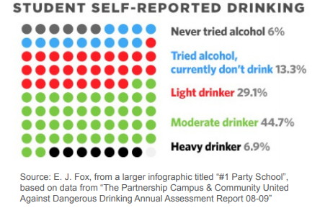
Unit Charts are for kids (cont’d)
https://perceptualedge.com/articles/visual_business_intelligence/unit_charts_are_for_kids.pdf

Slide 16
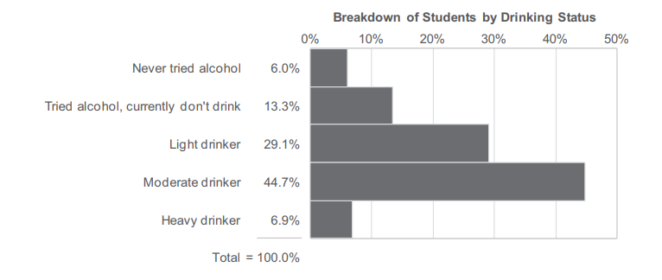
Unit Charts are for kids, continued
But aggregate statistics can hide complexities

Slide 17
Simpson’s Paradox
WOMEN
MEN
http://vudlab.com/simpsons/

Slide 18
W M
W M
W M
W M
W M
W M
Link to holograph demo

Slide 19
But aggregate statistics can hide complexities
Holograph: Dave Brown
DEMO 1

Slide 20
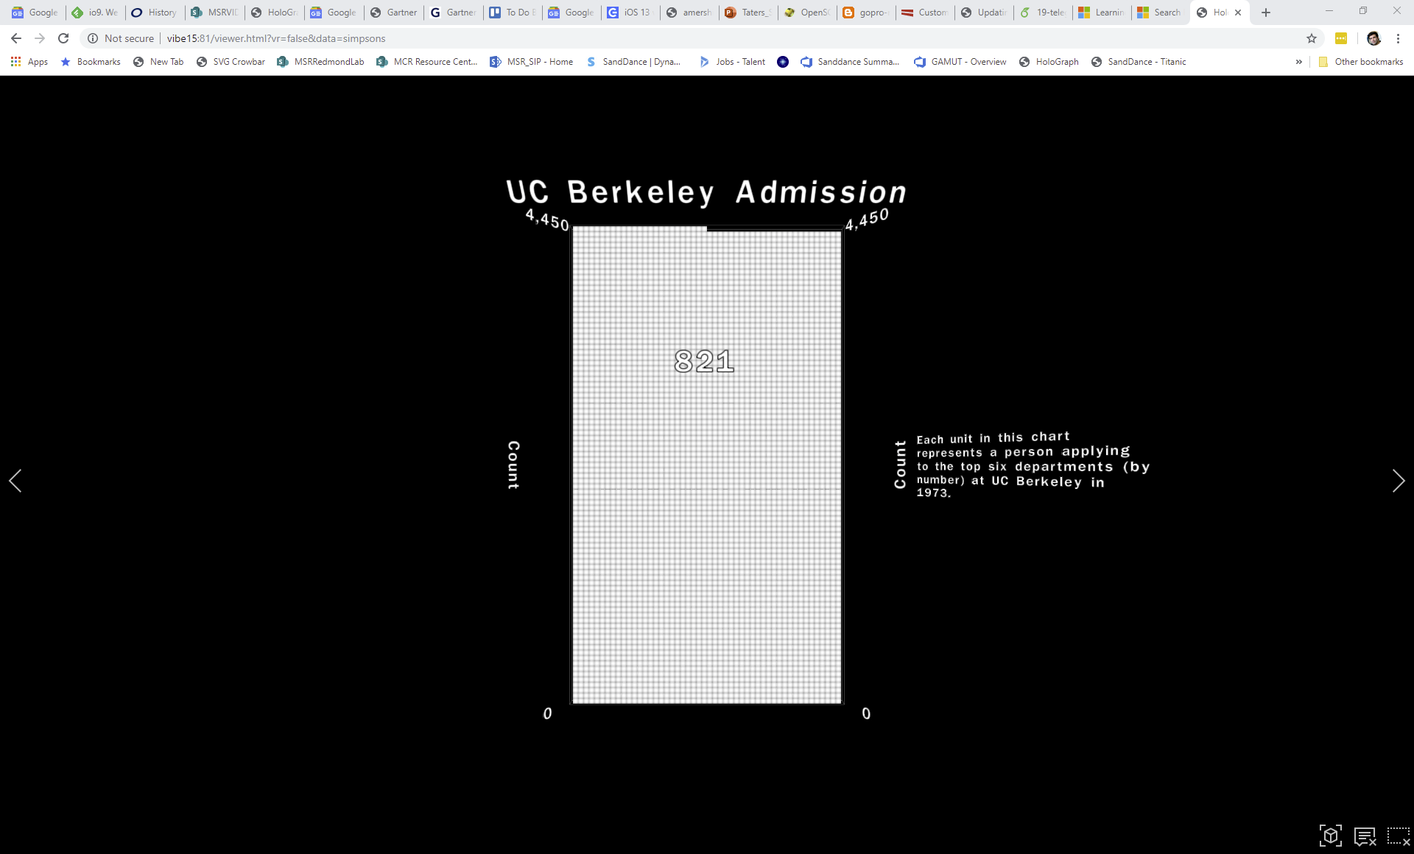

Slide 21
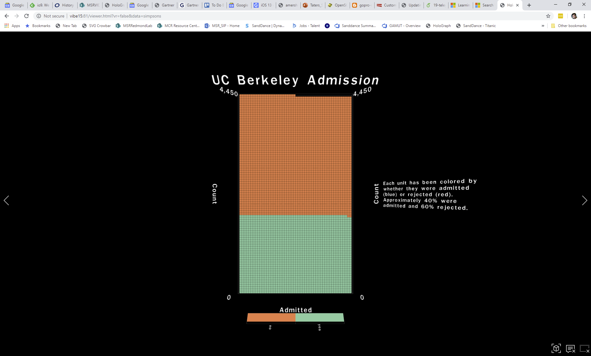

Slide 22
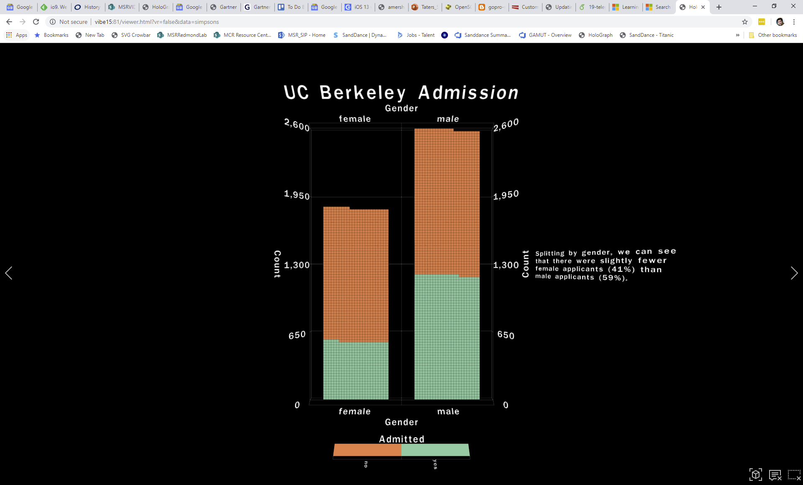

Slide 23
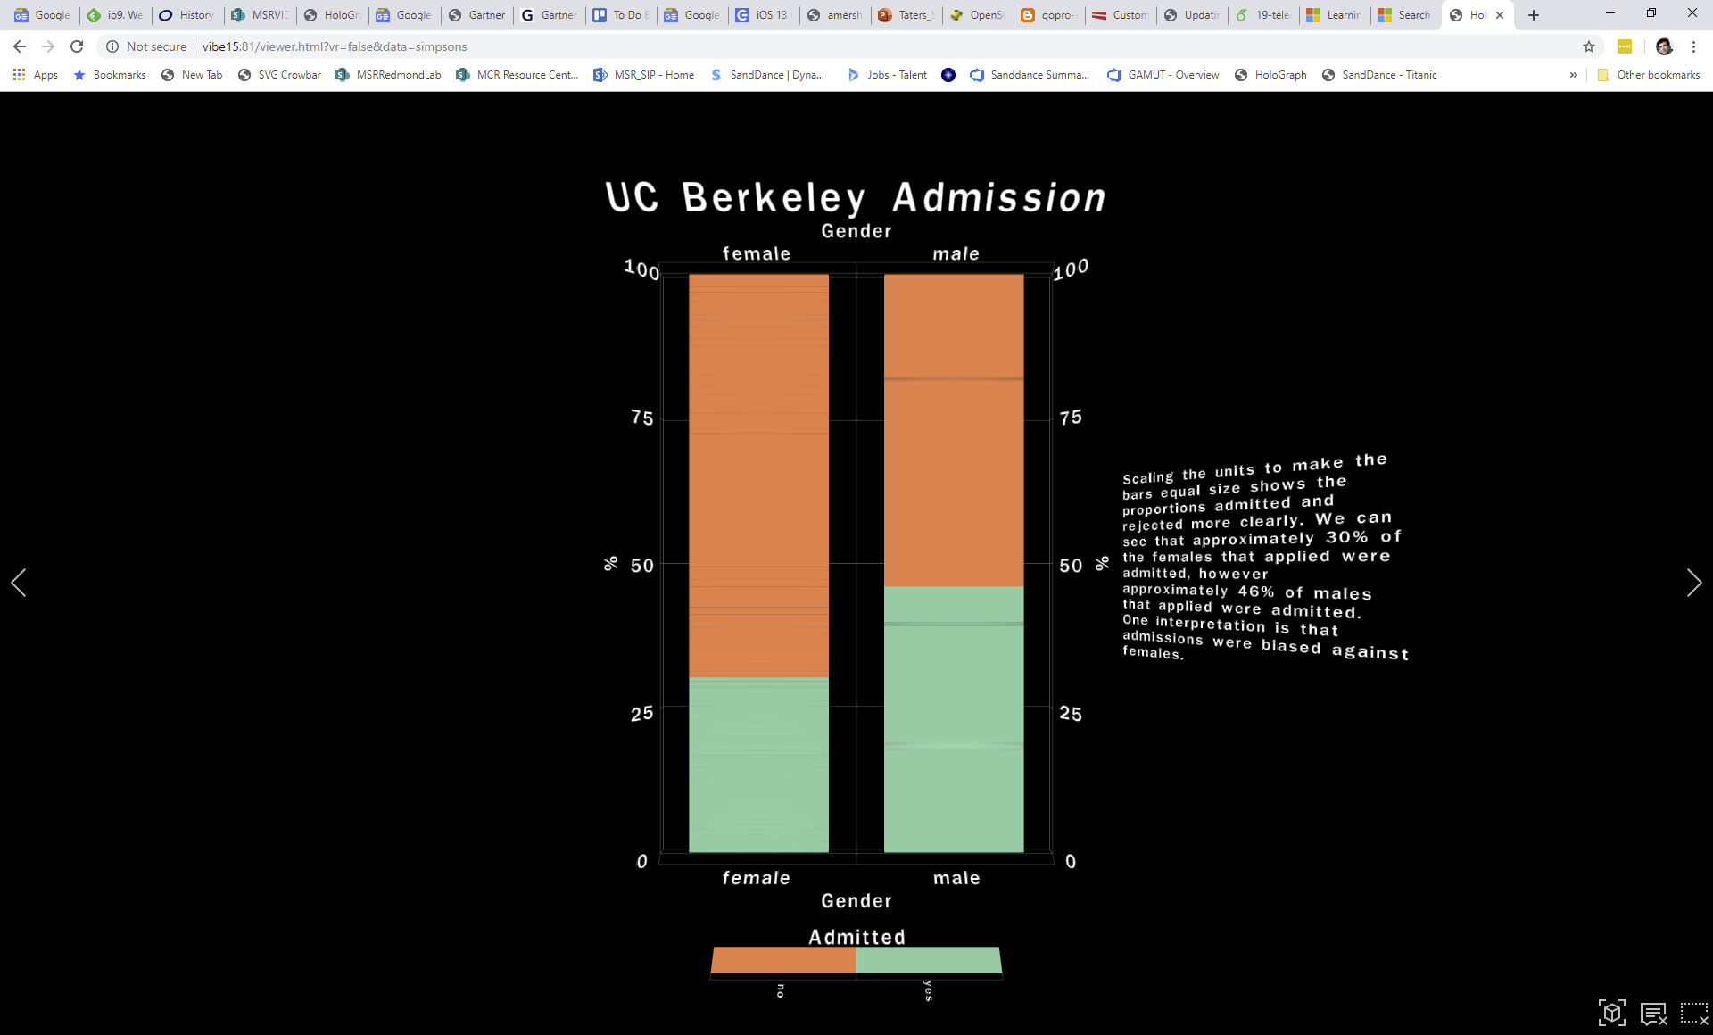

Slide 24
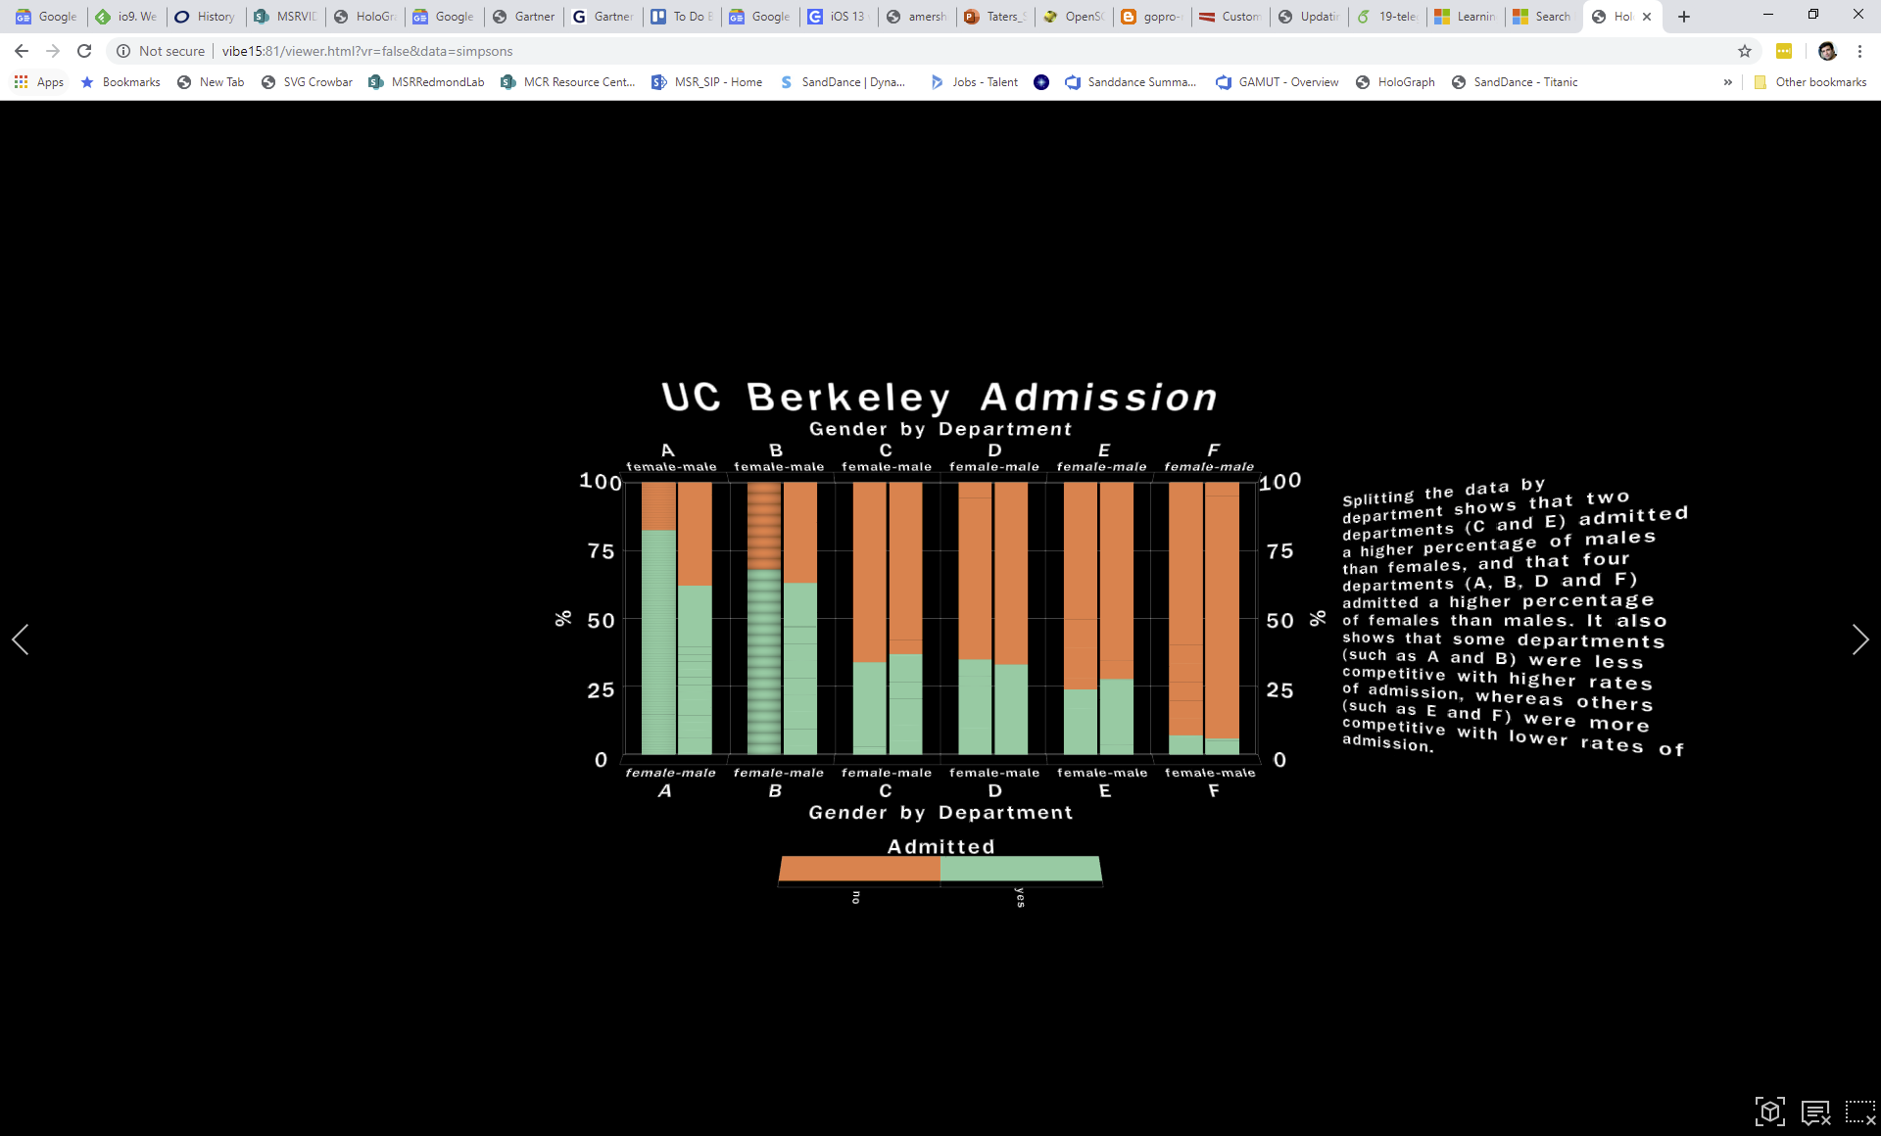

Slide 25
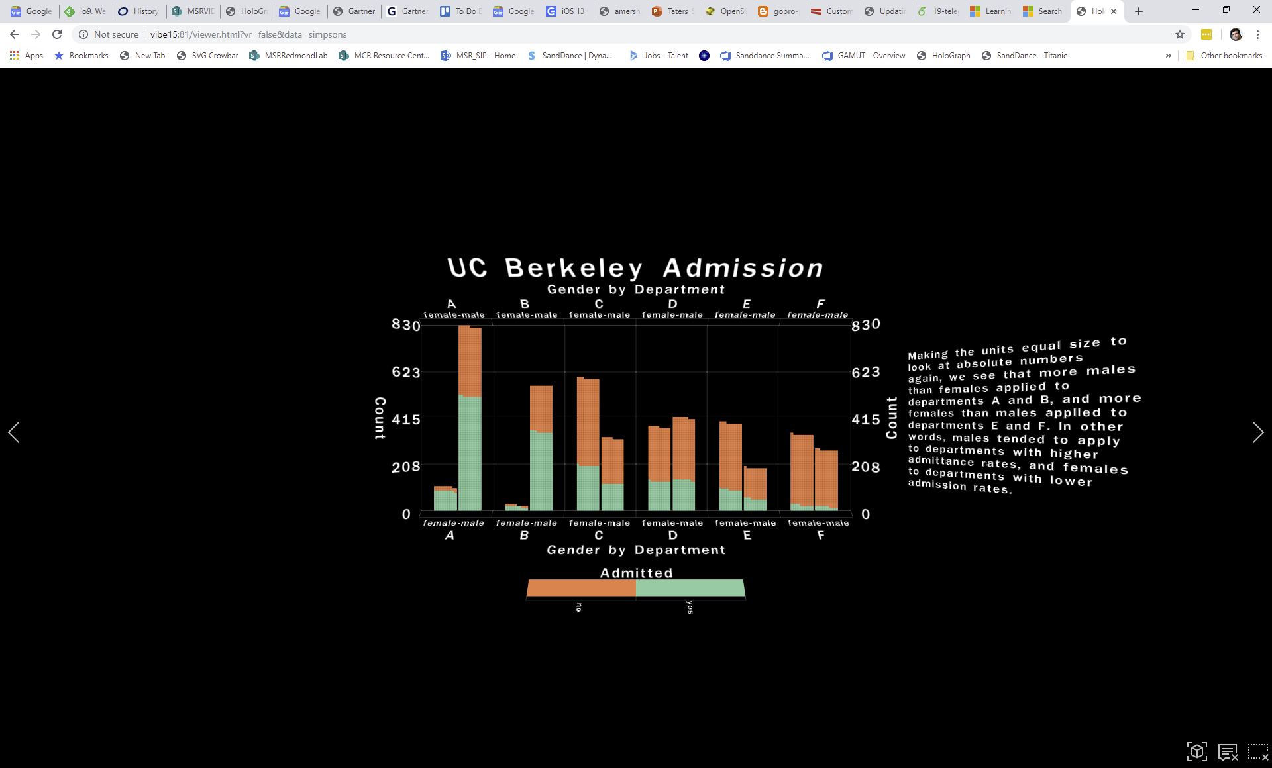

Slide 26
And reasoning about probabilities can be deceptive/confusing

Slide 27
Bayes Rule: Simple problem
1% of women at age forty who participate in routine screening have breast cancer.
80% of women with breast cancer will get positive mammograms.
9.6% of women without breast cancer will also get positive mammograms.
A woman in this age group had a positive mammography in a routine screening. What is the probability that she actually has breast cancer?
0-30%
30-60%
60-100%

Slide 28
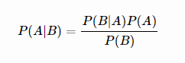
Baye’s Rule

Slide 29
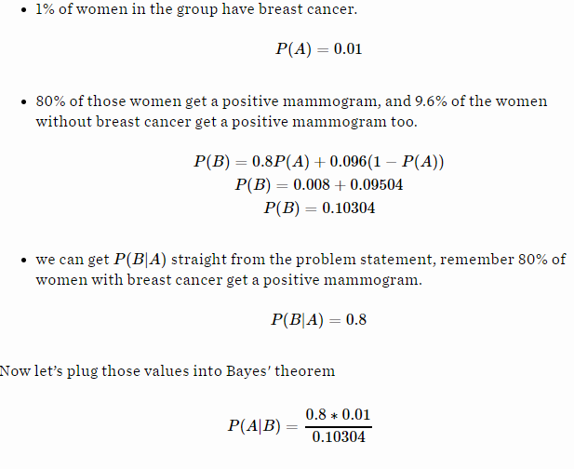
7.76%
95% of doctors said it’s between 70-80%

Slide 30
Holograph: Dave Brown
DEMO 2

Slide 31
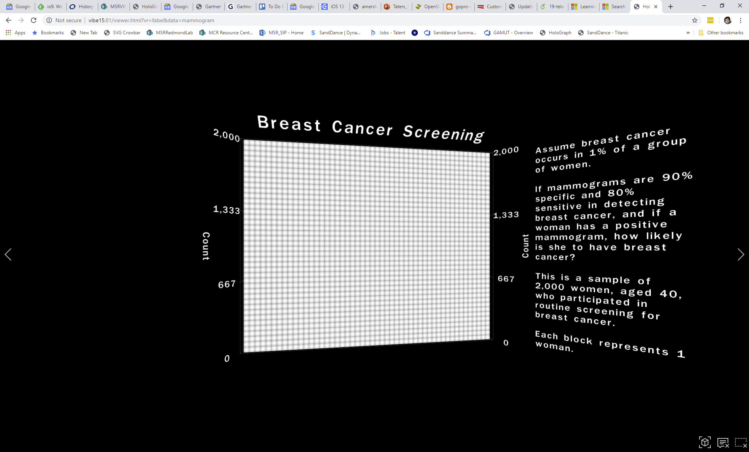

Slide 32
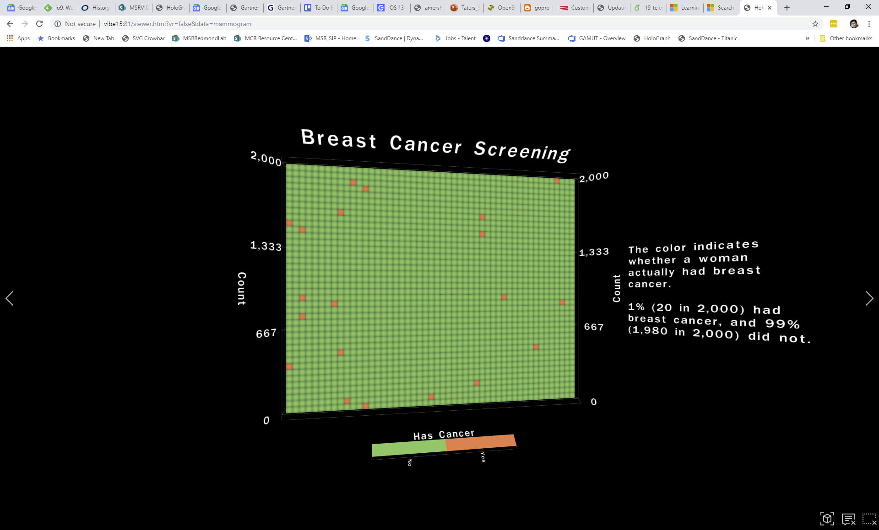

Slide 33
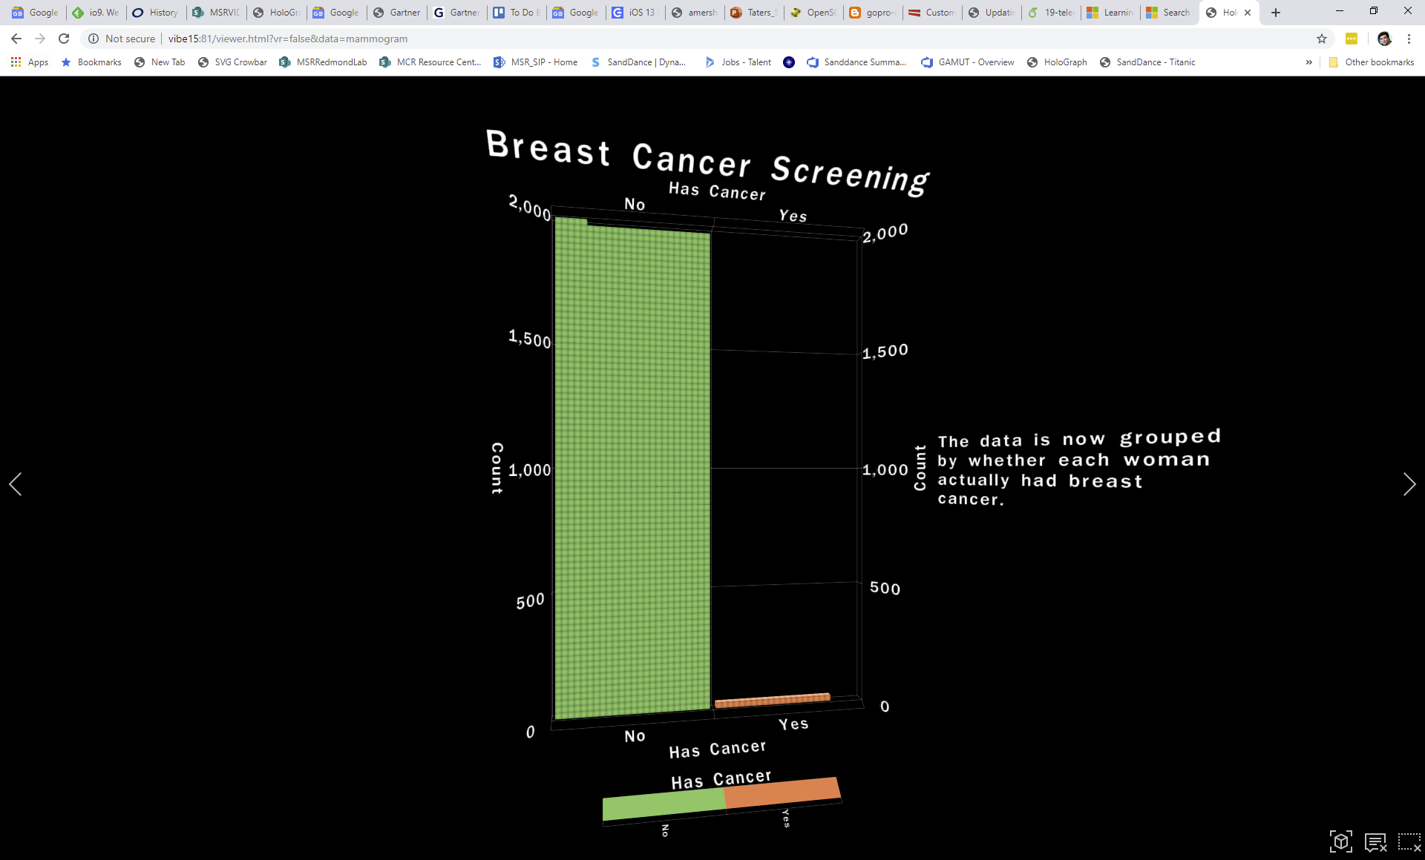

Slide 34
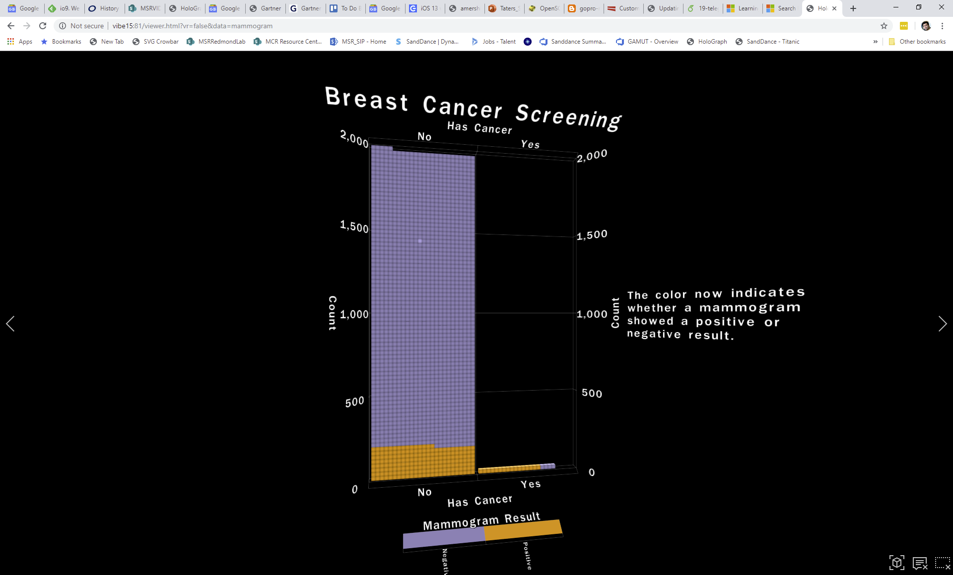

Slide 35
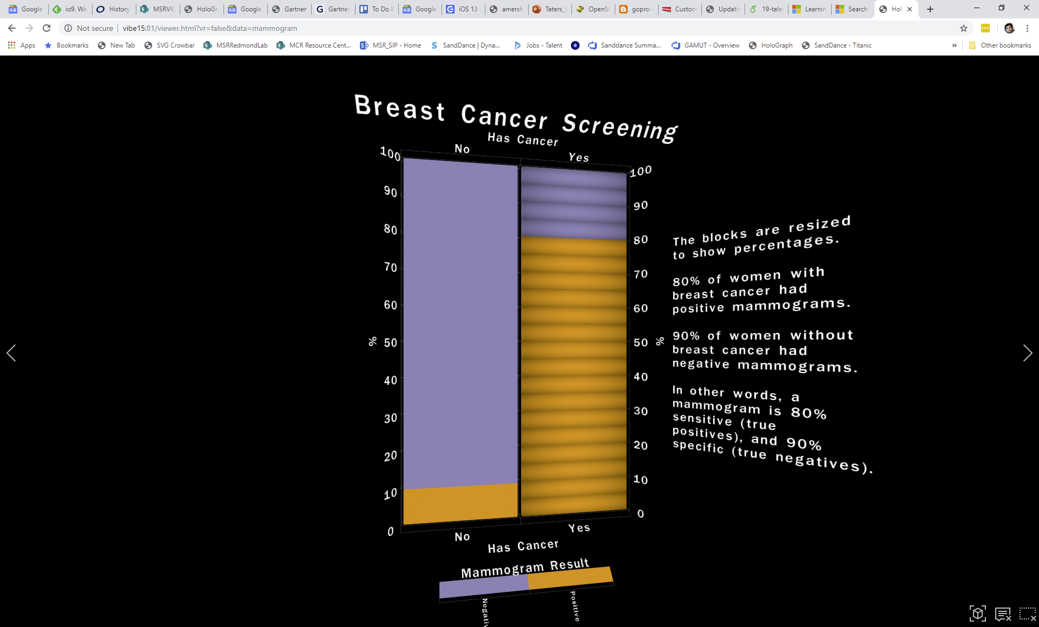

Slide 36
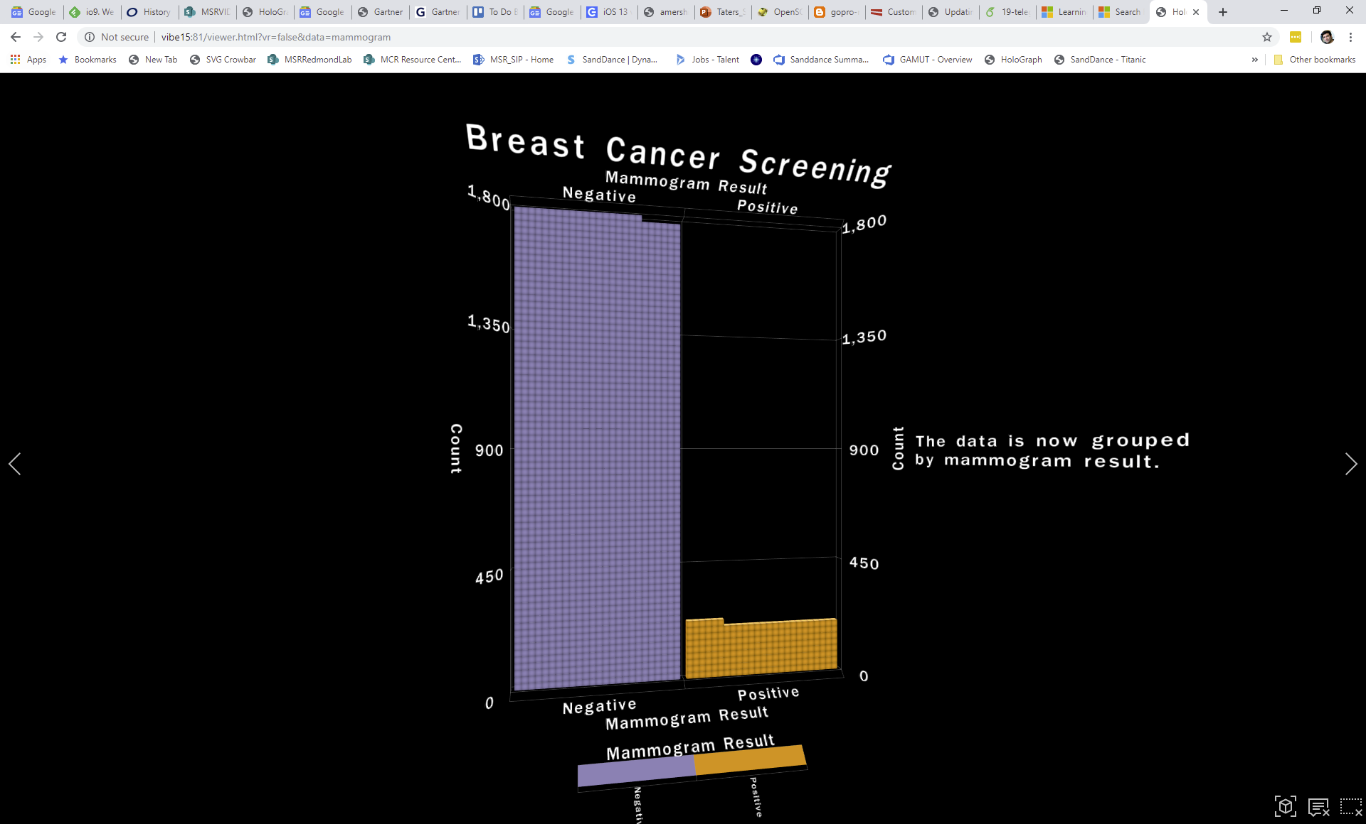

Slide 37
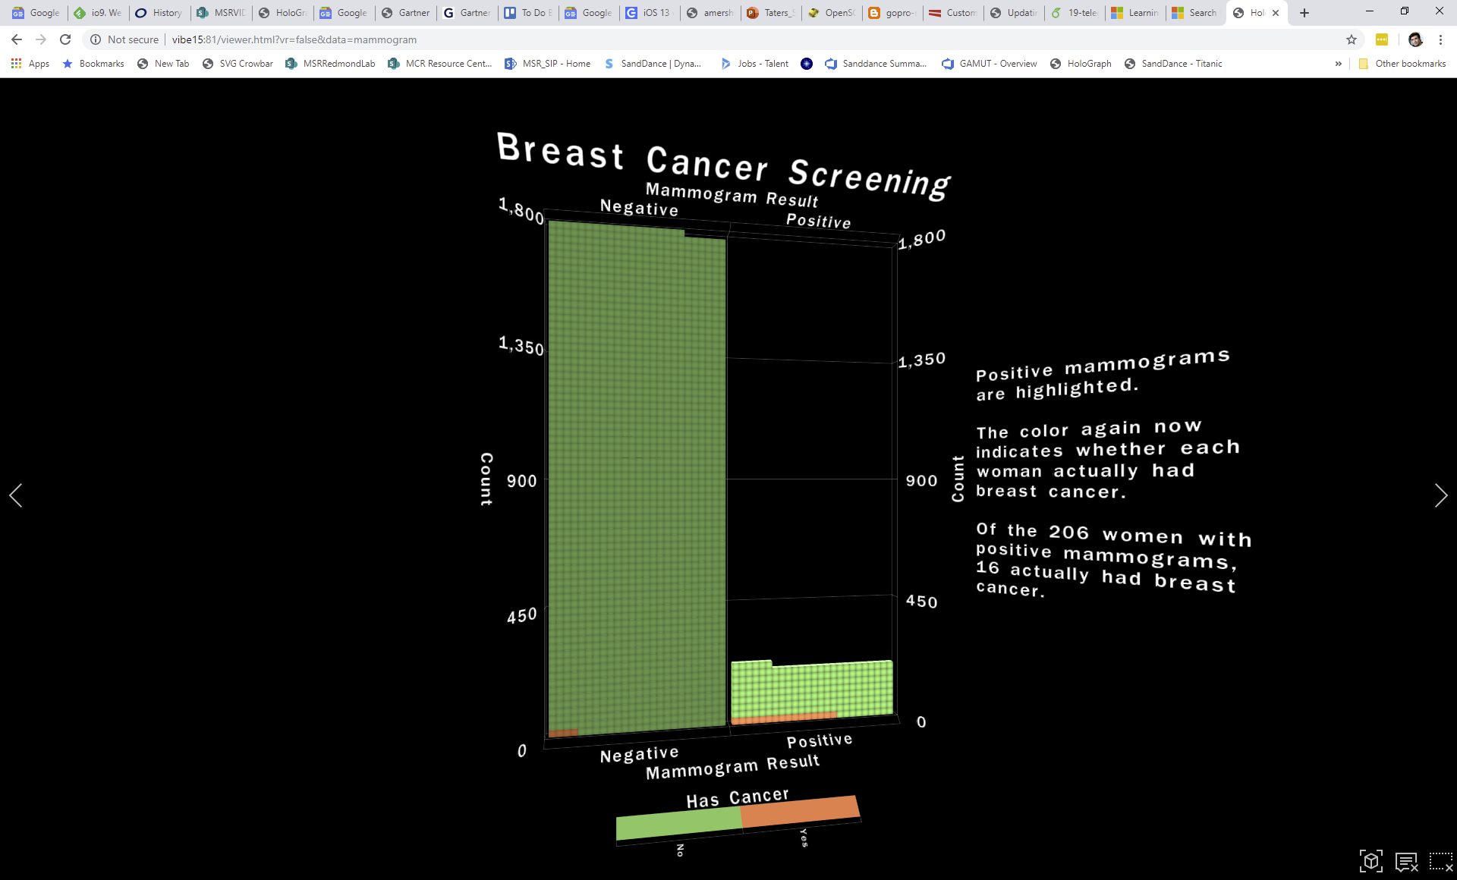

Slide 38
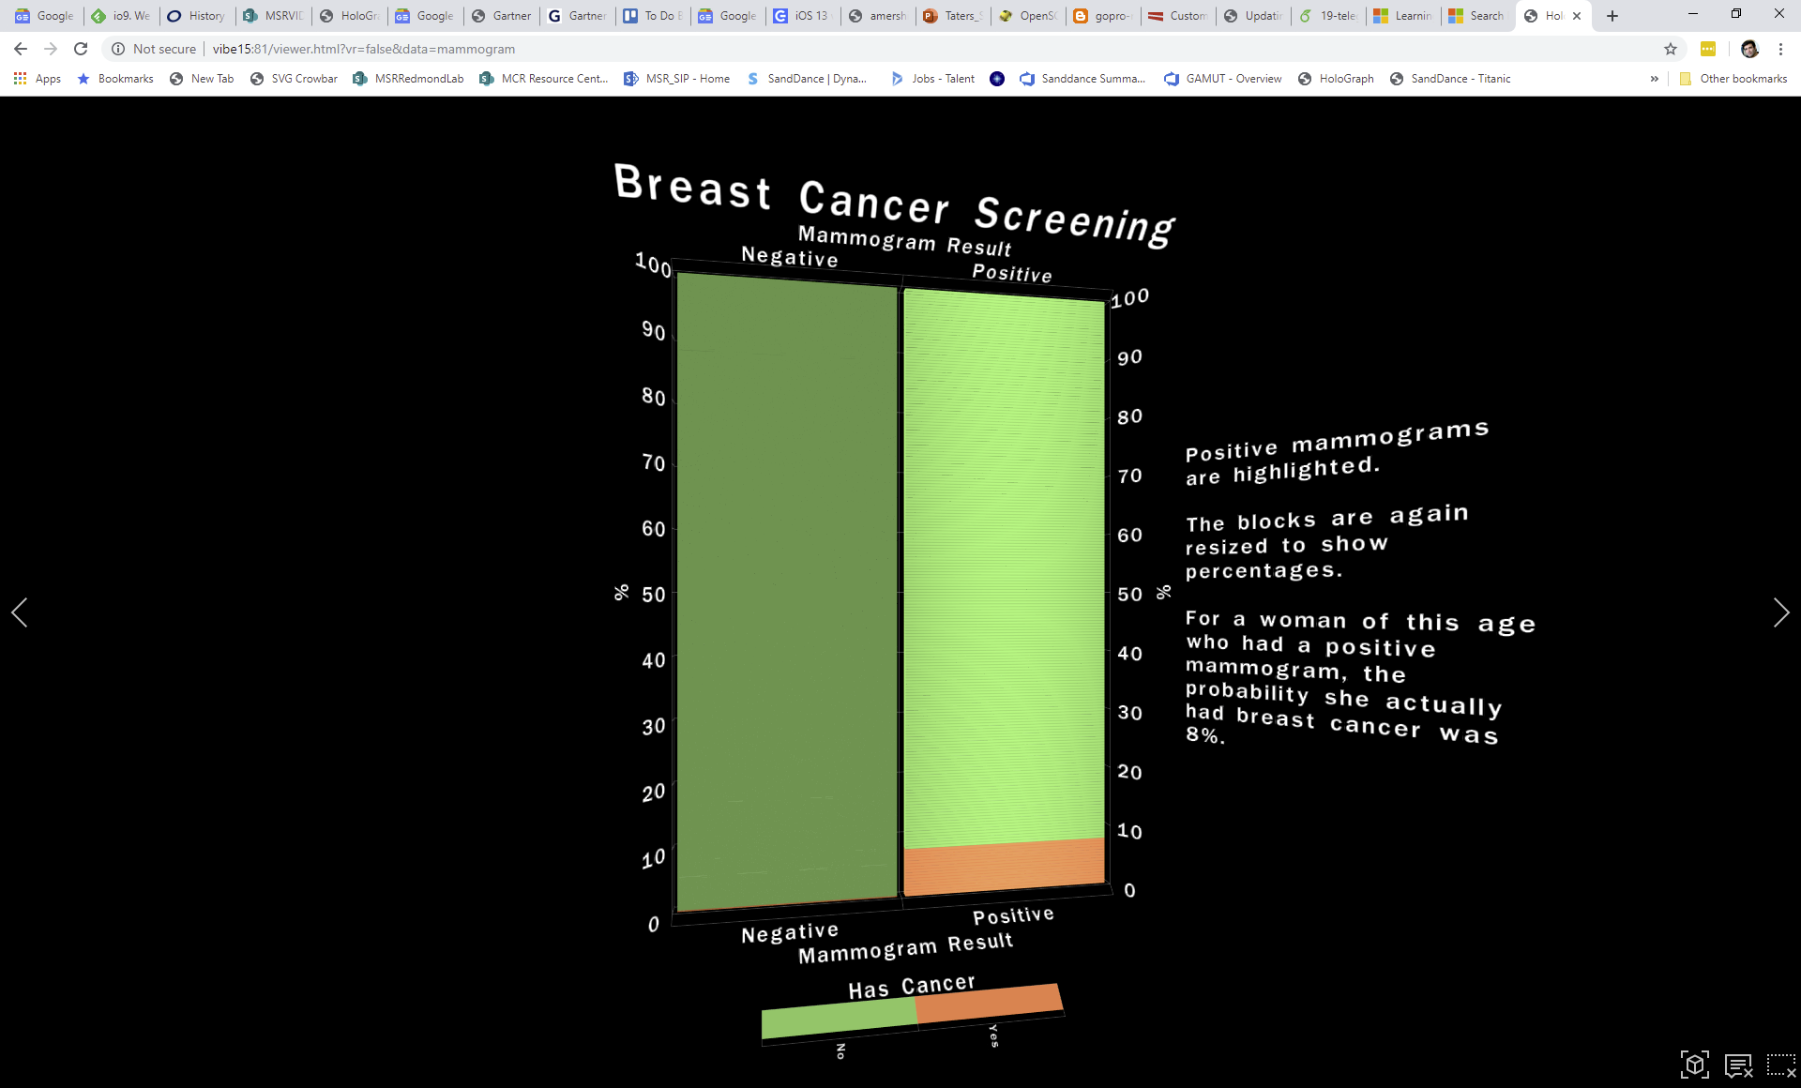

Slide 39
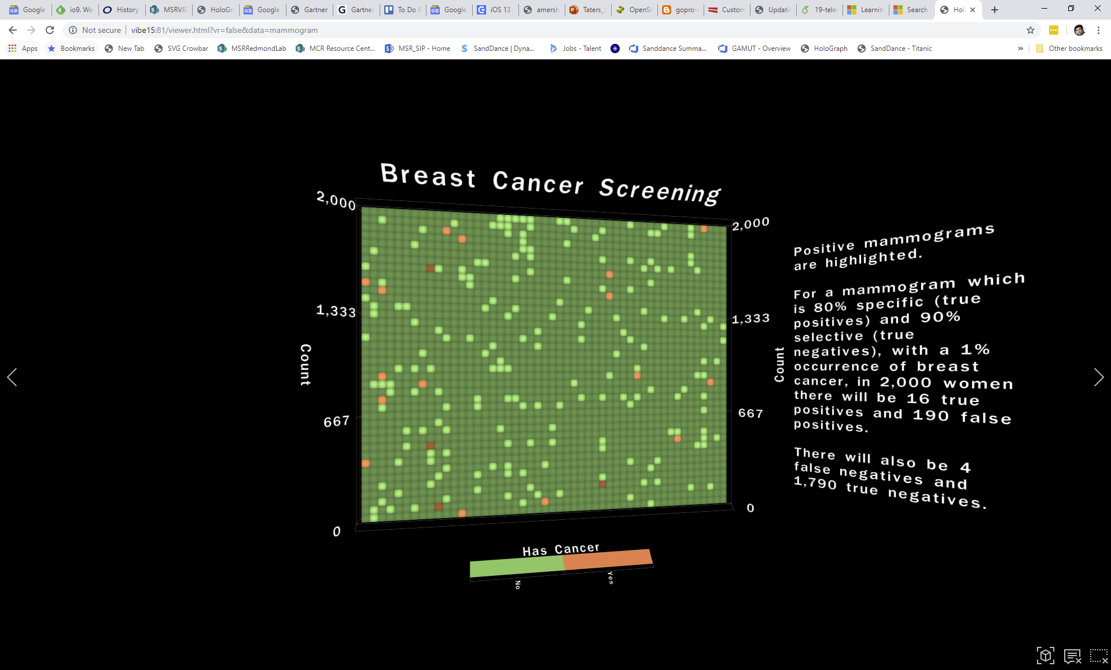

Slide 40
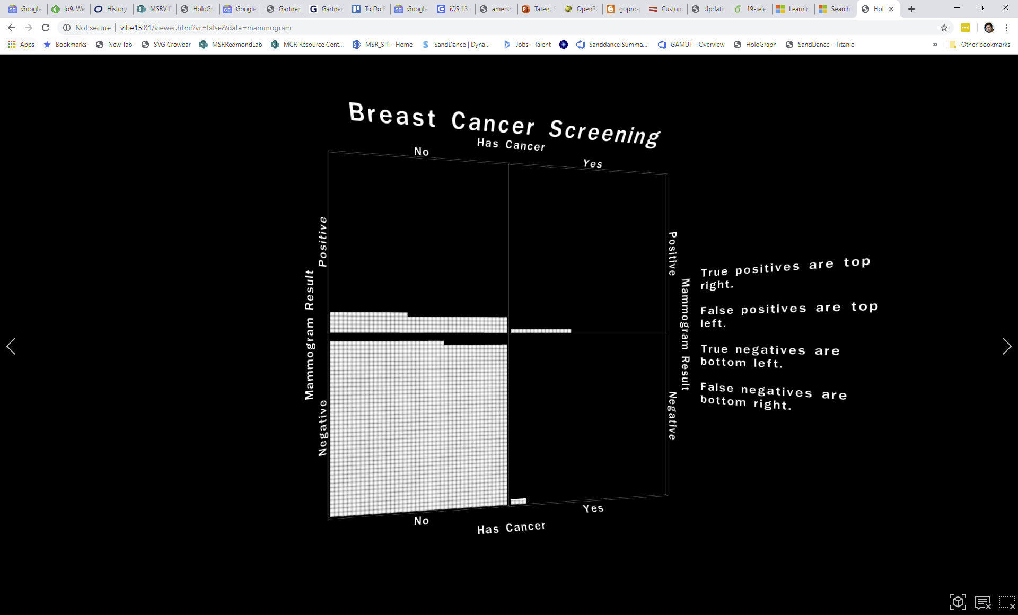

Slide 41
SandDance & Holograph
Demo of SandDance with demographic info
Demo of SandDance with Titanic Info
Link to Holograph with Titanic Story
Drucker, S., & Fernandez, R. (2015). A unifying framework for animated and interactive unit visualizations. Microsoft Research.
https://microsoft.github.io/SandDance/ (contact Dan.Marshall@microsoft.com)
http://www.sanddance.ms (old site, with documentation, videos, and blog)
Holograph to be released

Slide 43
SandDance
Unify categorical and numerical data and allow for straightforward mapping of attributes into visual features (e.g. aesthetics)
Since all marks are the same, allow for selection of different layouts which all are unified by mark representation
Make units selectable, searchable, and filterable.
Layout can be accomplished using Grammar of Graphics principles (VEGA)

Slide 44
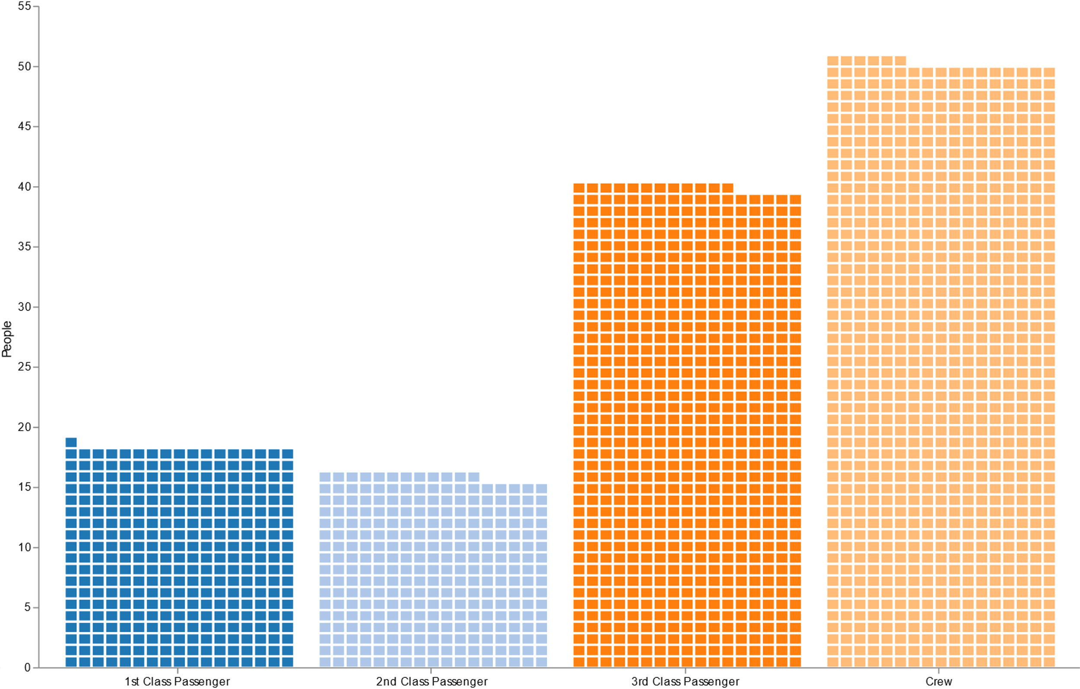

Slide 45


Slide 46
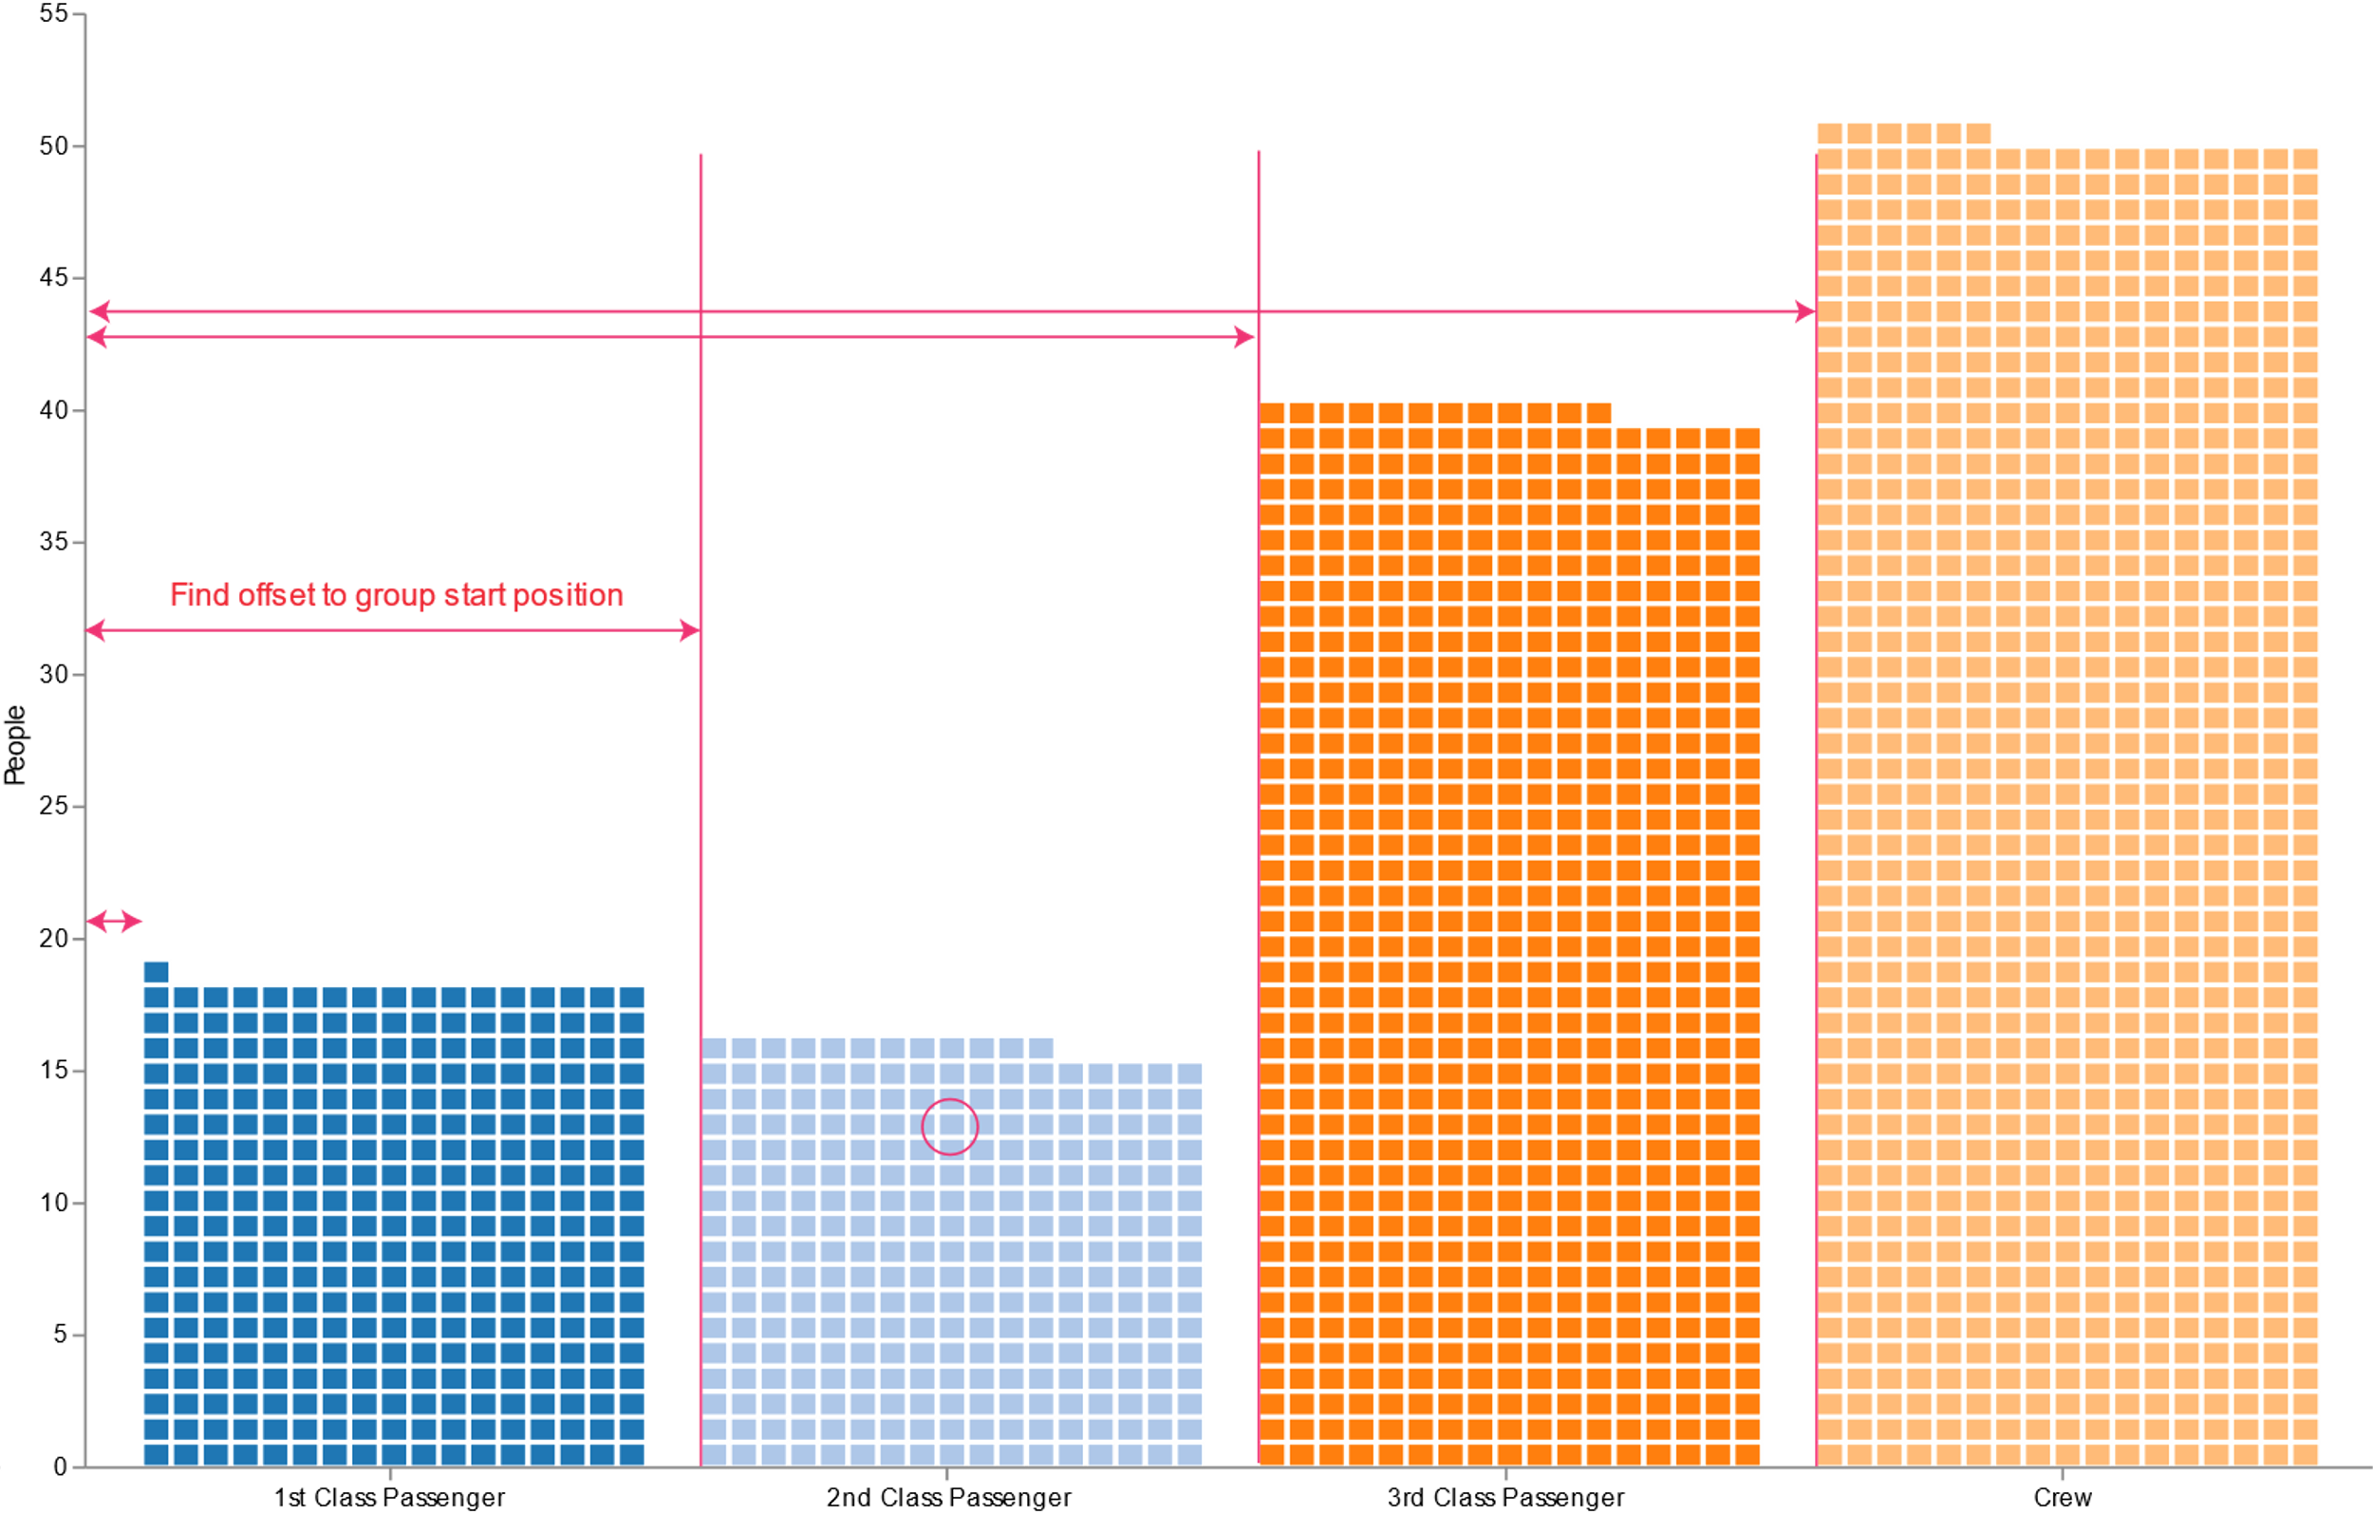

Slide 47


Slide 48
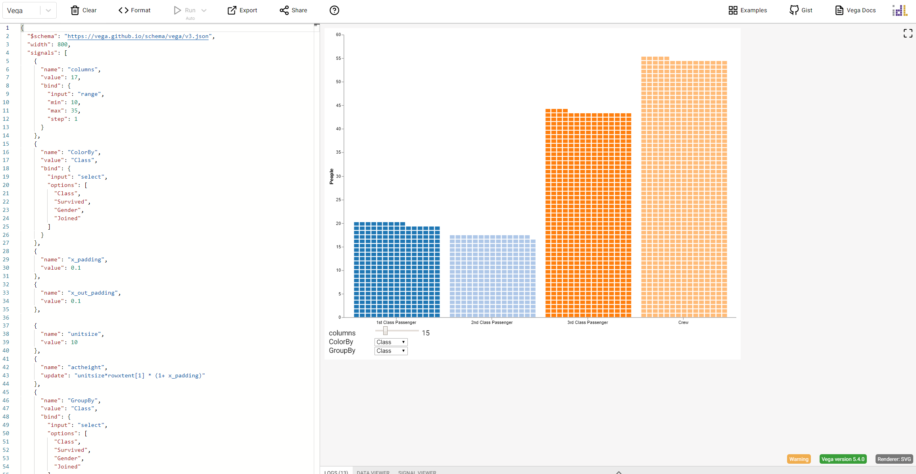
Example in VEGA Online Editor
http://aka.ms/AA56ms7

Slide 49
https://microsoft.github.io/SandDance/tests/umd/transition.html
(Copy VEGA specs into SandDance transition editor)

Slide 50
ATOM: Grammar for Unit Visualizations
Nested grammar of primitive operations
Park, D., Drucker, S. M., Fernandez, R., & Elmqvist, N. (2018). Atom: A grammar for unit visualizations. IEEE transactions on visualization and computer graphics, 24(12), 3032-3043.

Slide 51
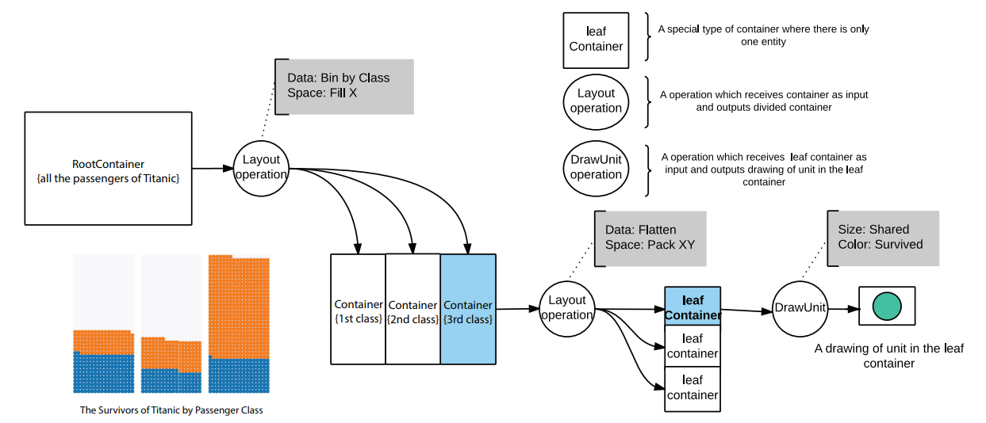

Slide 52
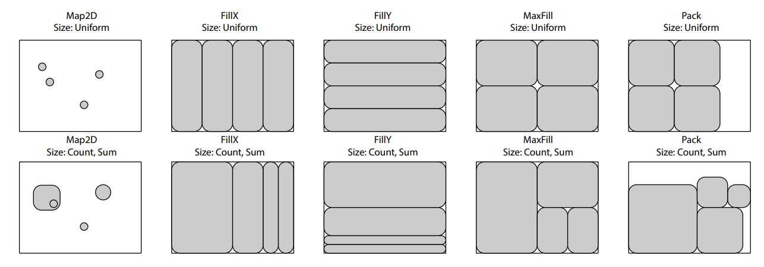

Slide 53
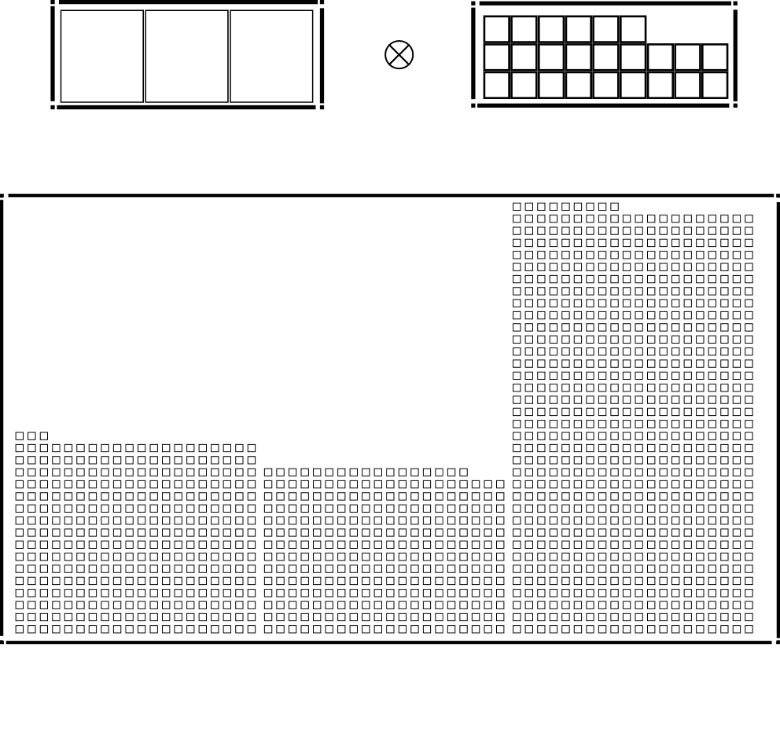

Slide 54
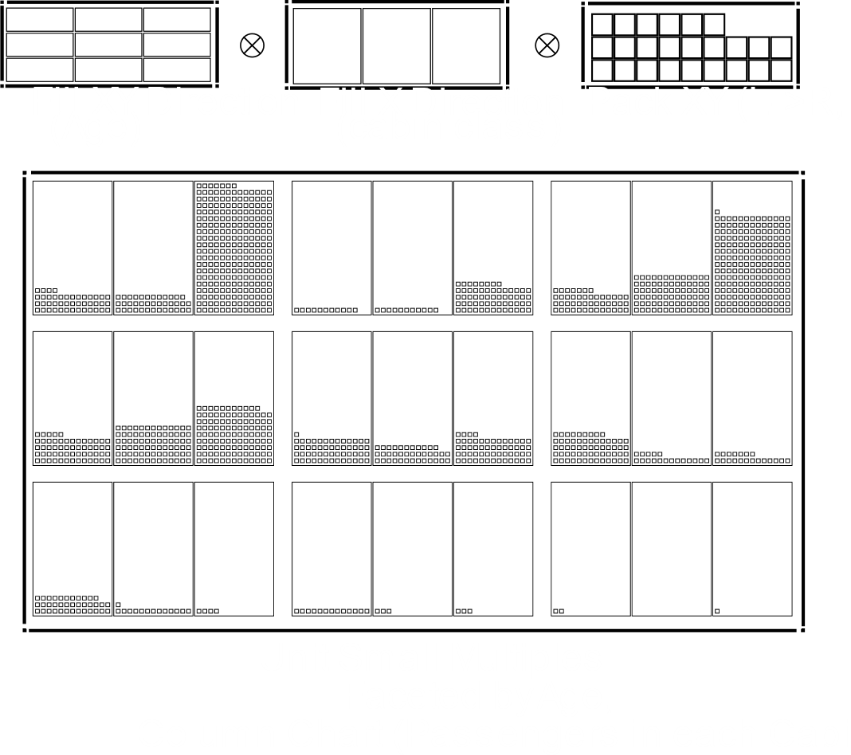

Slide 55
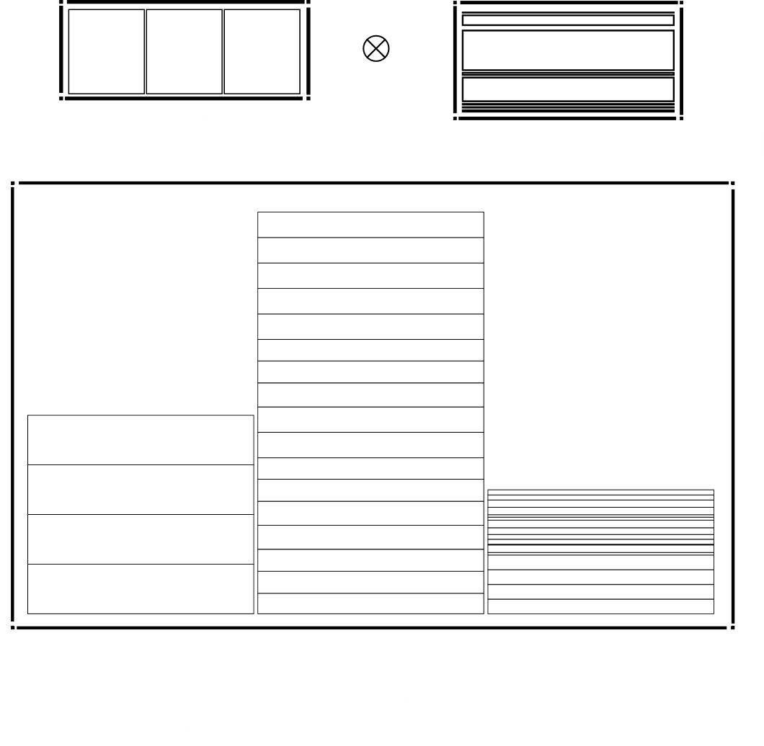

Slide 56
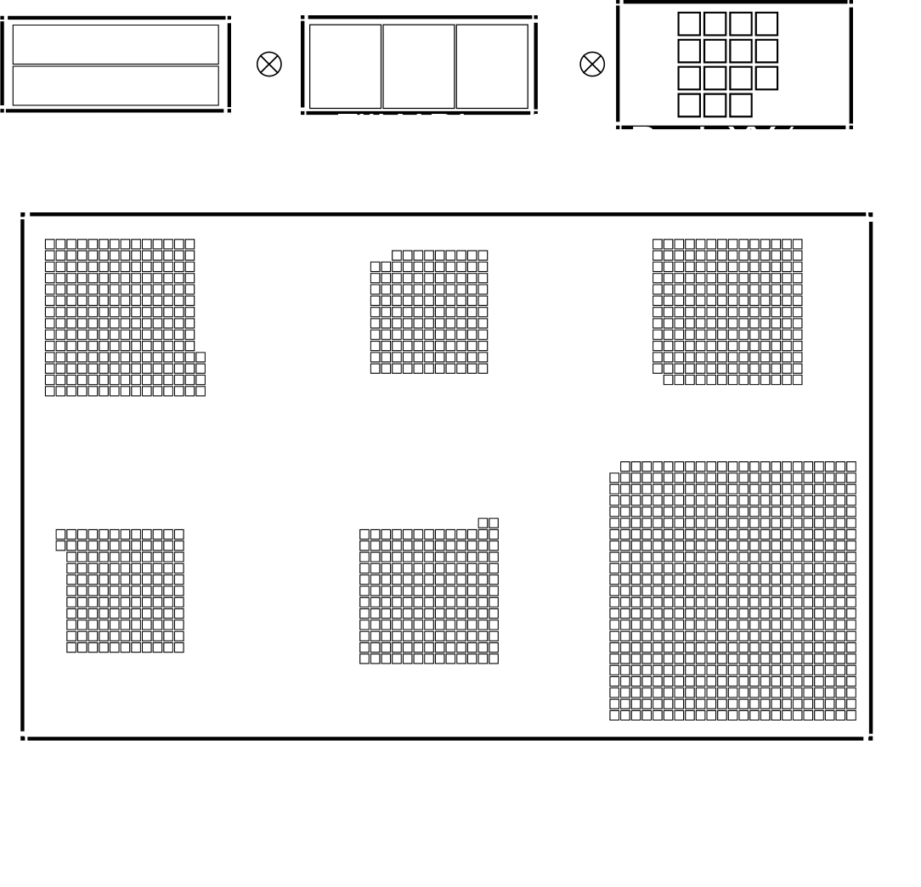

Slide 57
Summary: Pros and Cons
Unit Visualizations fit well within the GoG paradigm (they just don’t emphasize aggregation)
Most layouts can be done through clever statistical transformations and mark placement
The marks allow for common unit for selection, animation and interaction
Can be highly effective for communicating insights within data by showing a family of related visualization unified by a common unit representation.
Can be effective for finding insights as well (moving between different representations of the same data0
Not as appropriate with massive amounts of data or pre-aggregated data

Slide 58
Summary (cont’d)
Can create bespoke applications OR incorporate existing open source code into new applications
Contact me: Steven Drucker (sdrucker@microsoft.com)
MSR VIDA Group (http://aka.ms/VIDA )
http://research.microsoft.com/~sdrucker
SandDance (https://microsoft.github.io/SandDance/)
Holograph (TBD)

